Slide 1

Cancer statistic, epidemiology and risk factors
Prof. Emil Makimbetov
email: makimbetovemil@rambler.ru

Slide 2
Introduction
Noncommunicable diseases (NCDs) are now responsible for the majority of global deaths, and cancer is expected to rank as the leading cause of death and the single most important barrier to increasing life expectancy in every country of the world in the 21st century. According to estimates from the World Health Organization (WHO) in 2020, cancer is the first or second leading cause of death before age 70 years in 91 of 172 countries, and it ranks third or fourth in an additional 22 countries (Fig. 1).

Slide 3
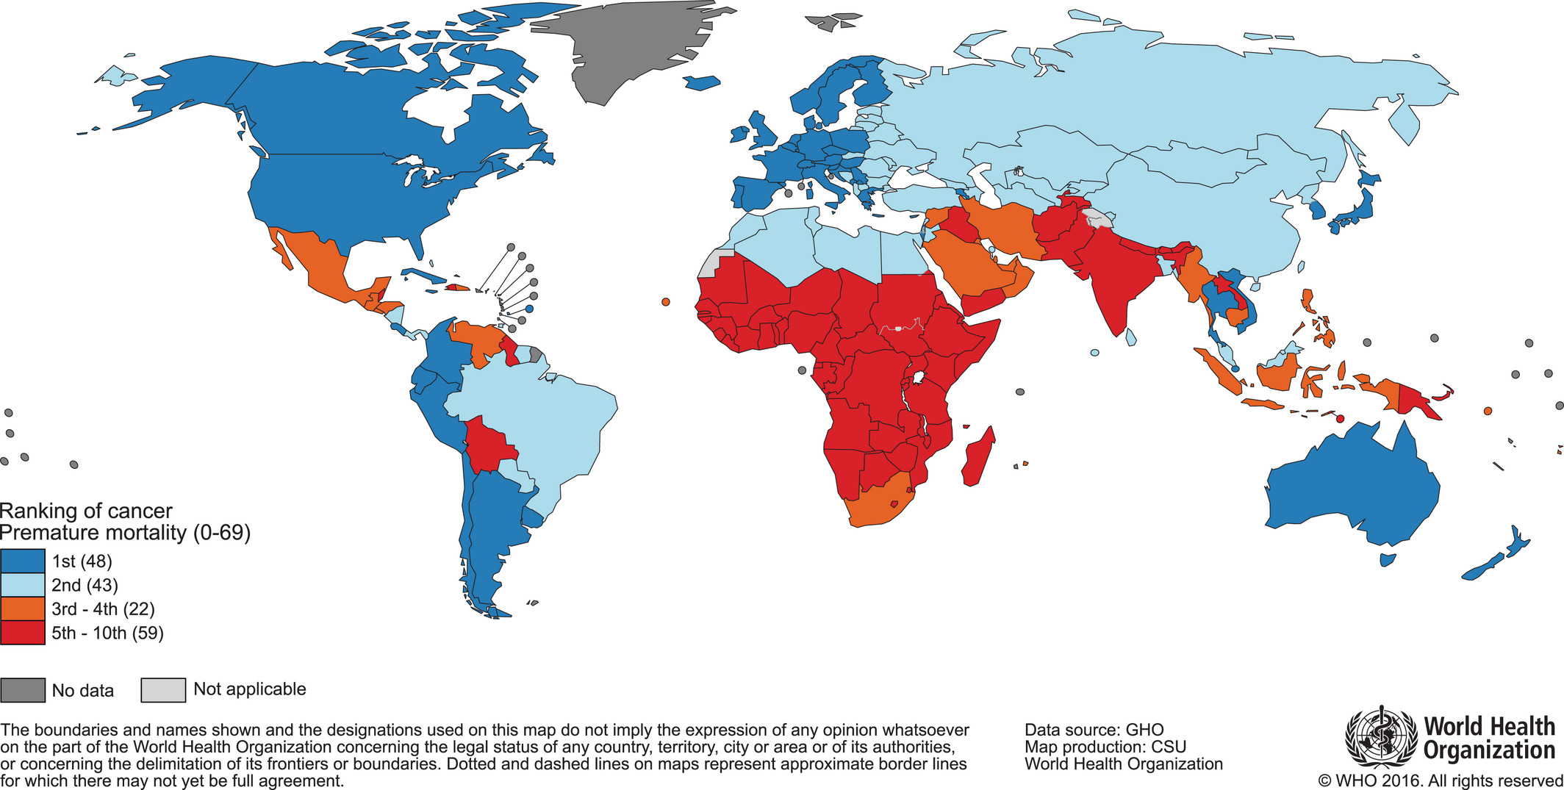
Global Map Presenting the National Ranking of Cancer as a Cause of Death at Ages Below 70 Years in 2020. The numbers of countries represented in each ranking group are included in the legend. Source: World Health Organization.

Slide 4
Cancer incidence and mortality are rapidly growing worldwide. The reasons are complex but reflect both aging and growth of the population, as well as changes in the prevalence and distribution of the main risk factors for cancer, several of which are associated with socioeconomic development.
With rapid population growth and aging worldwide, the rising prominence of cancer as a leading cause of death partly reflects marked declines in mortality rates of stroke and coronary heart disease, relative to cancer, in many countries.
The extent to which cancer’s position as a cause of premature death reflects national levels of social and economic development can be seen by comparing the maps in Figures 1 and 2A.

Slide 5
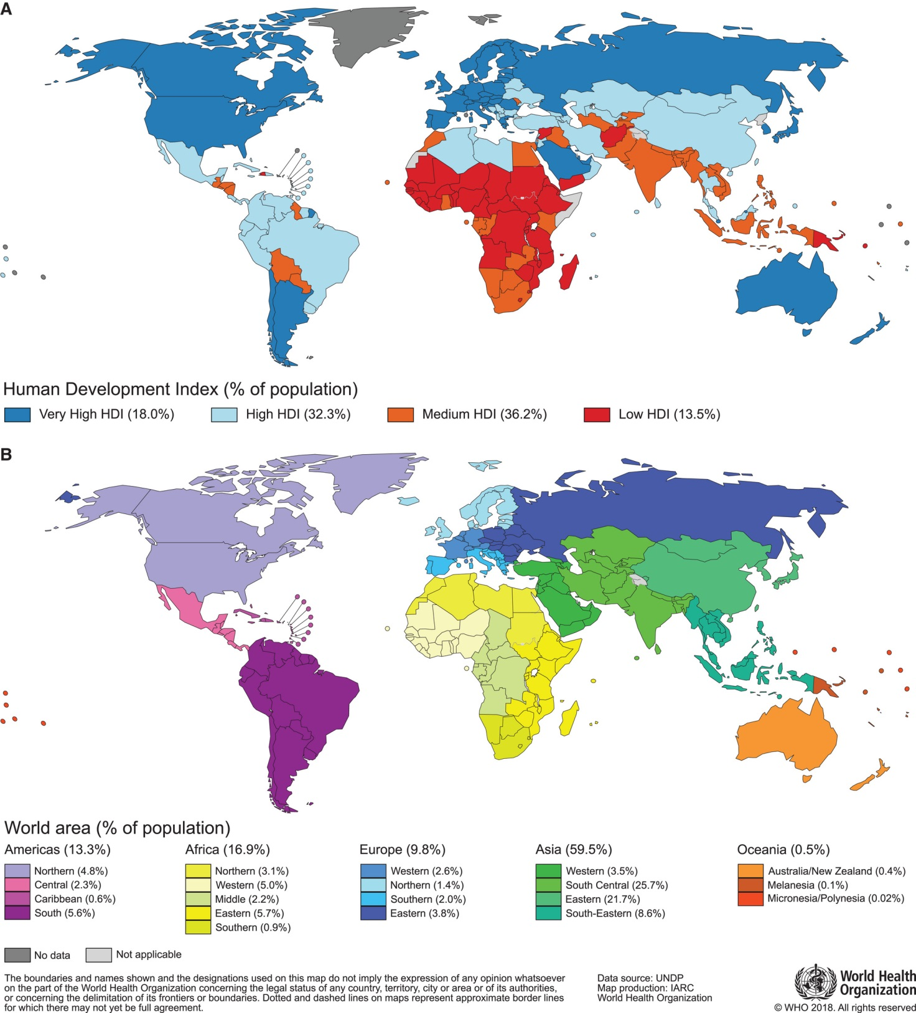

Slide 6
Cancer transitions are most striking in emerging economies, where an increasing magnitude of the disease is paralleled by a changing profile of common cancer types.
A recurring observation is the ongoing displacement of infection-related and poverty-related cancers by those cancers that already are highly frequent in the most developed countries (eg, in Europe, North America, and high-income countries in Asia and Oceania).
These cancers are often ascribed to a so-called westernization of lifestyle, yet the differing cancer profiles in individual countries and between regions signify that marked geographic diversity still exists, with a persistence of local risk factors in populations at quite different phases of social and economic transition.
This is illustrated by the prominent differences in rates of infection-associated cancers, including cervix, stomach, and liver, observed in countries at opposite ends of the human development spectrum.

Slide 7
A status report on the cancer burden worldwide in 2020, based on the GLOBOCAN 2020 estimates of cancer incidence and mortality produced by the International Agency for Research on Cancer (IARC).
We estimate that there were 20 million new cases (18.0 million excluding Non Melanoma Scin Cancer) and 9.6 million cancer deaths worldwide in 2020.

Slide 8
Distribution of Cases and Deaths by World Region and Cancer Types
Figure 3 presents the distribution of all-cancer incidence and mortality according to world area for both sexes combined and separately for men and women. For both sexes combined, it is estimated that nearly one-half of the cases and over one-half of the cancer deaths in the world will occur in Asia in the year 2018, in part because close to 60% of the global population resides there (Fig. 2B). Europe accounts for 23.4% of the total cancer cases and 20.3% of the cancer deaths, although it represents only 9% of the global population, followed by the Americas’ 21% of incidence and 14.4% of mortality worldwide. In contrast to other regions, the shares of cancer deaths in Asia (57.3%) and Africa (7.3%) are higher than the shares of incidence (48.4% and 5.8%, respectively) because of the different distribution of cancer types and higher case fatality rates in these regions.

Slide 9
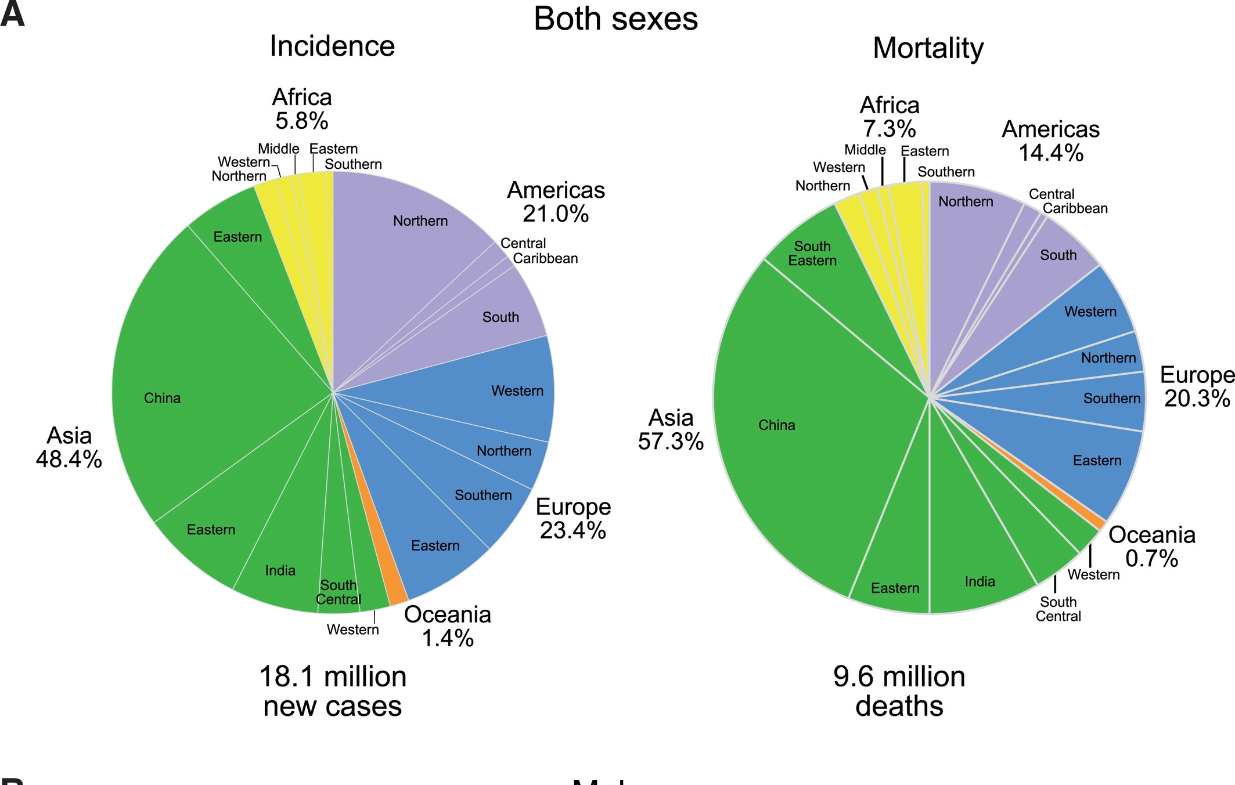

Slide 10
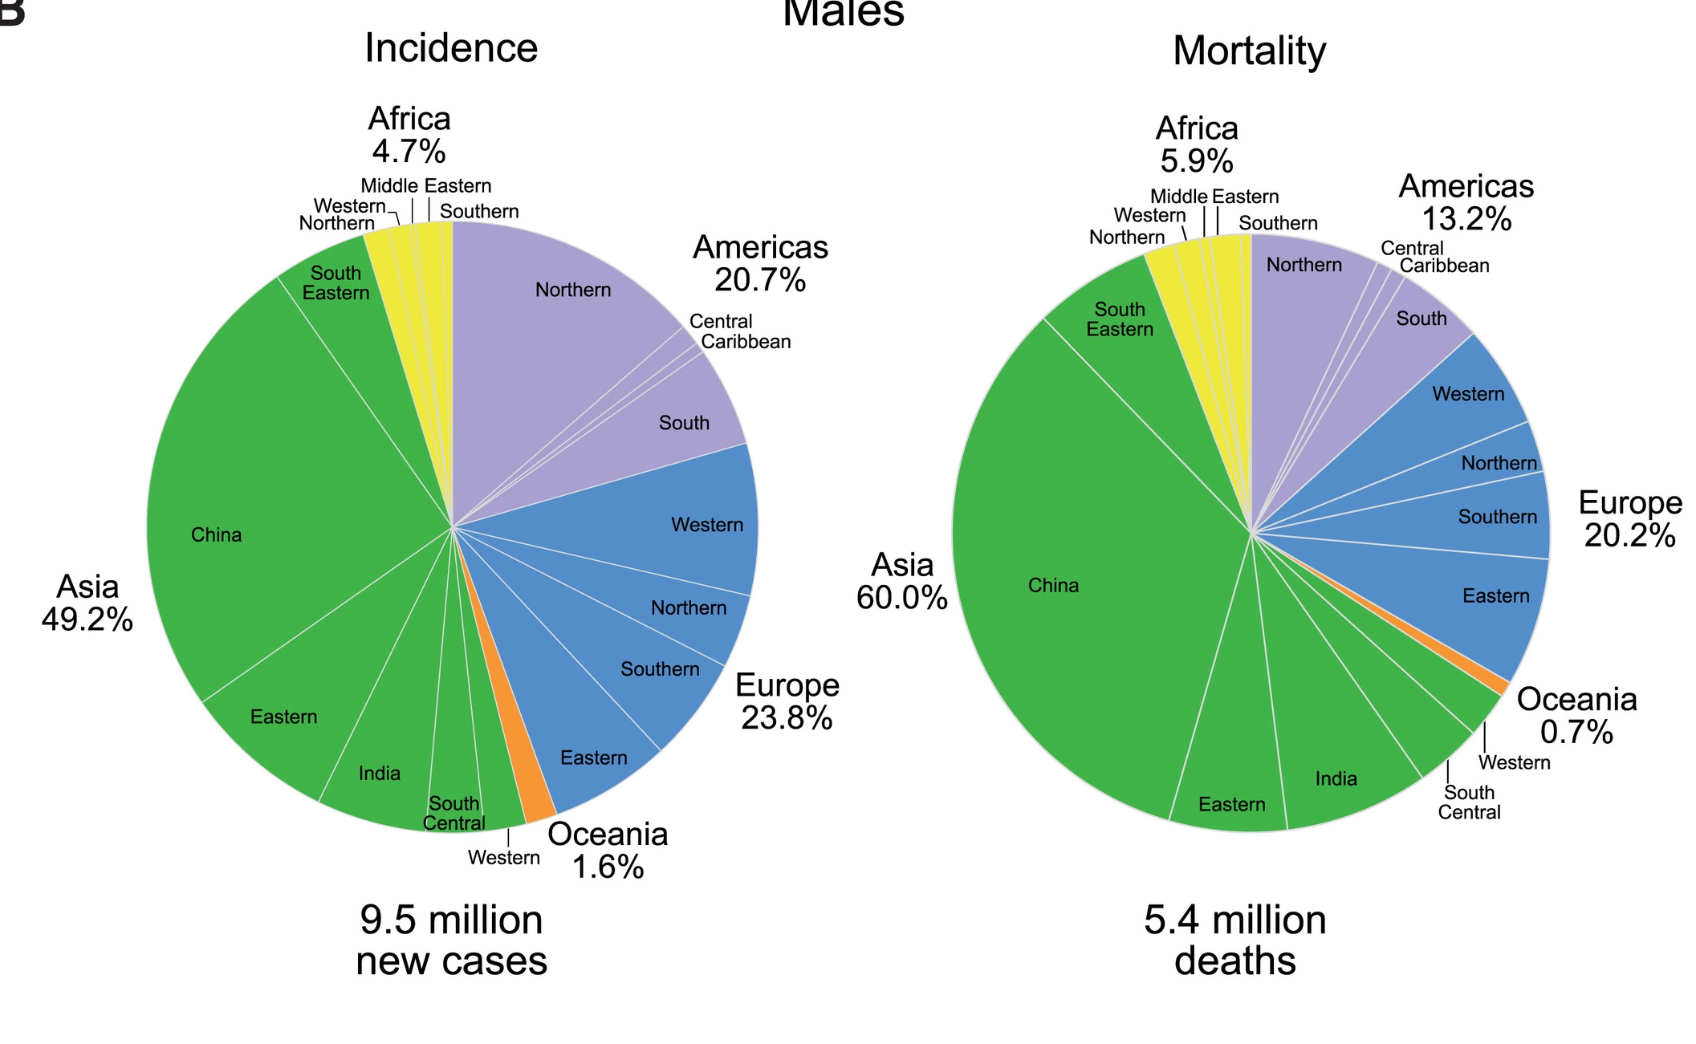

Slide 11
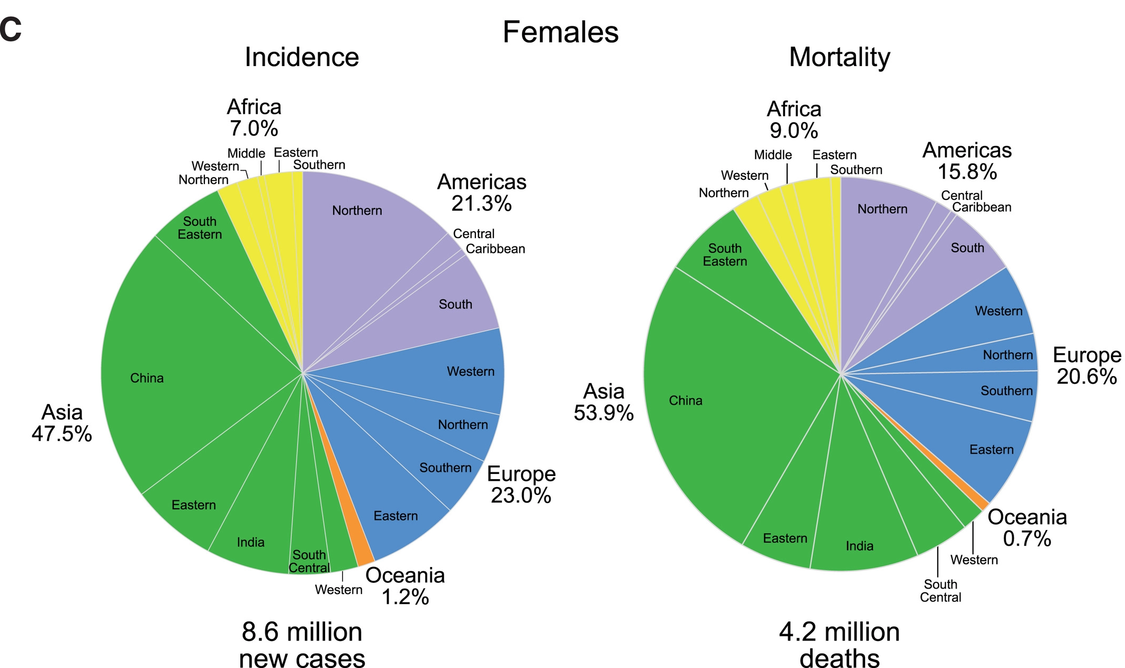

Slide 12
Figure 4 shows the top 10 cancer types for estimated cases and deaths worldwide for men and women, combined and separately, with NMSC included within the other category.
For both sexes combined, lung cancer is the most commonly diagnosed cancer (11.6% of the total cases) and the leading cause of cancer death (18.4% of the total cancer deaths), closely followed by female breast cancer (11.6%), colorectal cancer (10.2%), and prostate cancer (7.1%) for incidence and colorectal cancer (9.2%), stomach cancer (8.2%), and liver cancer (8.2%) for mortality.
By sex, lung cancer is the most commonly diagnosed cancer and the leading cause of cancer death in males, followed by prostate and colorectal cancer for incidence, and liver and stomach cancer for mortality.
Among females, breast cancer is the most commonly diagnosed cancer and the leading cause of cancer death, followed by colorectal and lung cancer for incidence, and vice versa for mortality; cervical cancer ranks fourth for both incidence and mortality. Overall, the top 10 cancer types account for over 65% of newly diagnosed cancer cases and deaths.

Slide 13
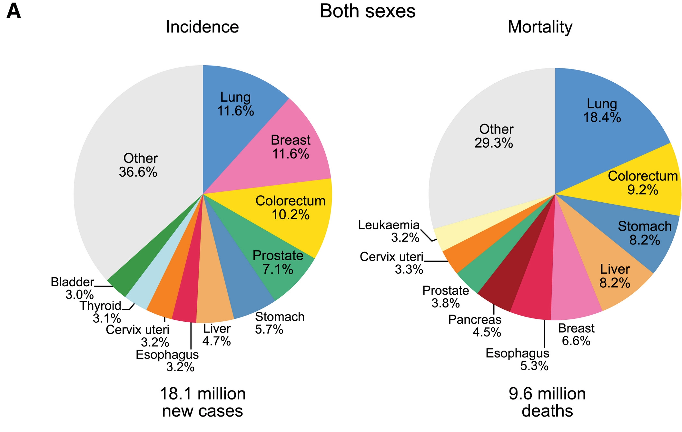

Slide 14
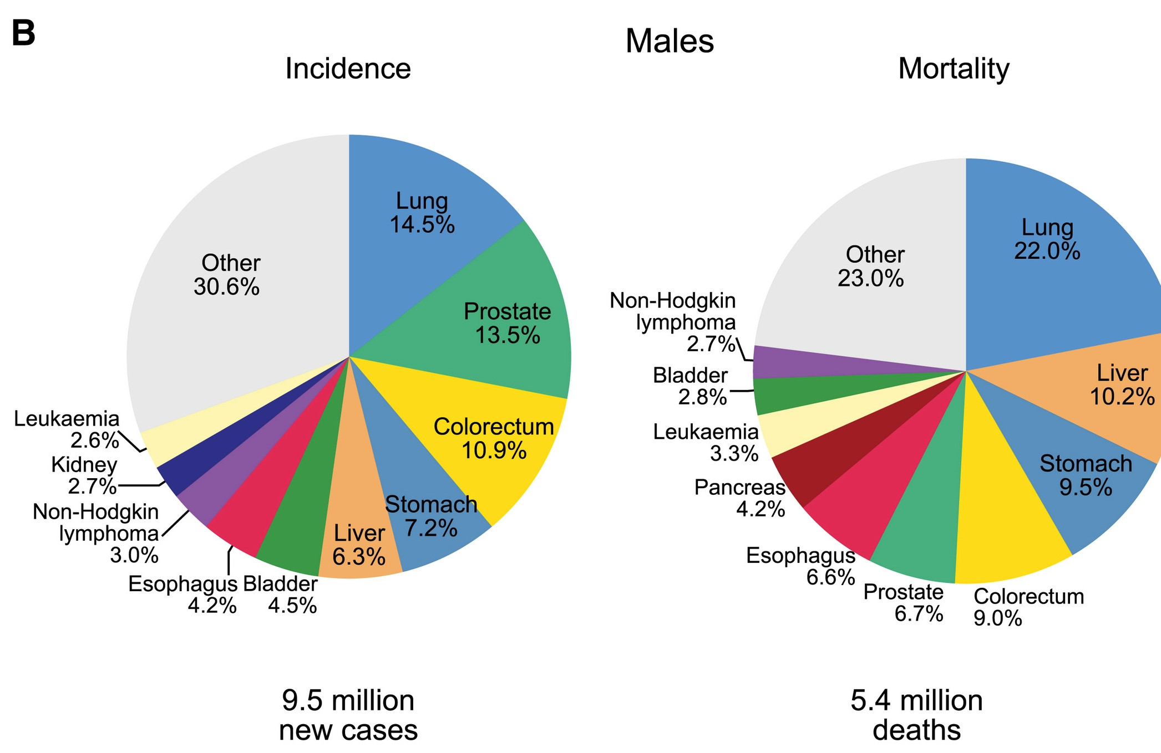

Slide 15
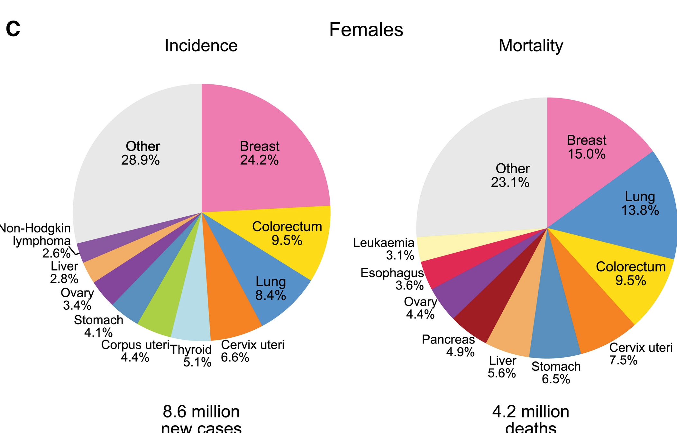

Slide 16
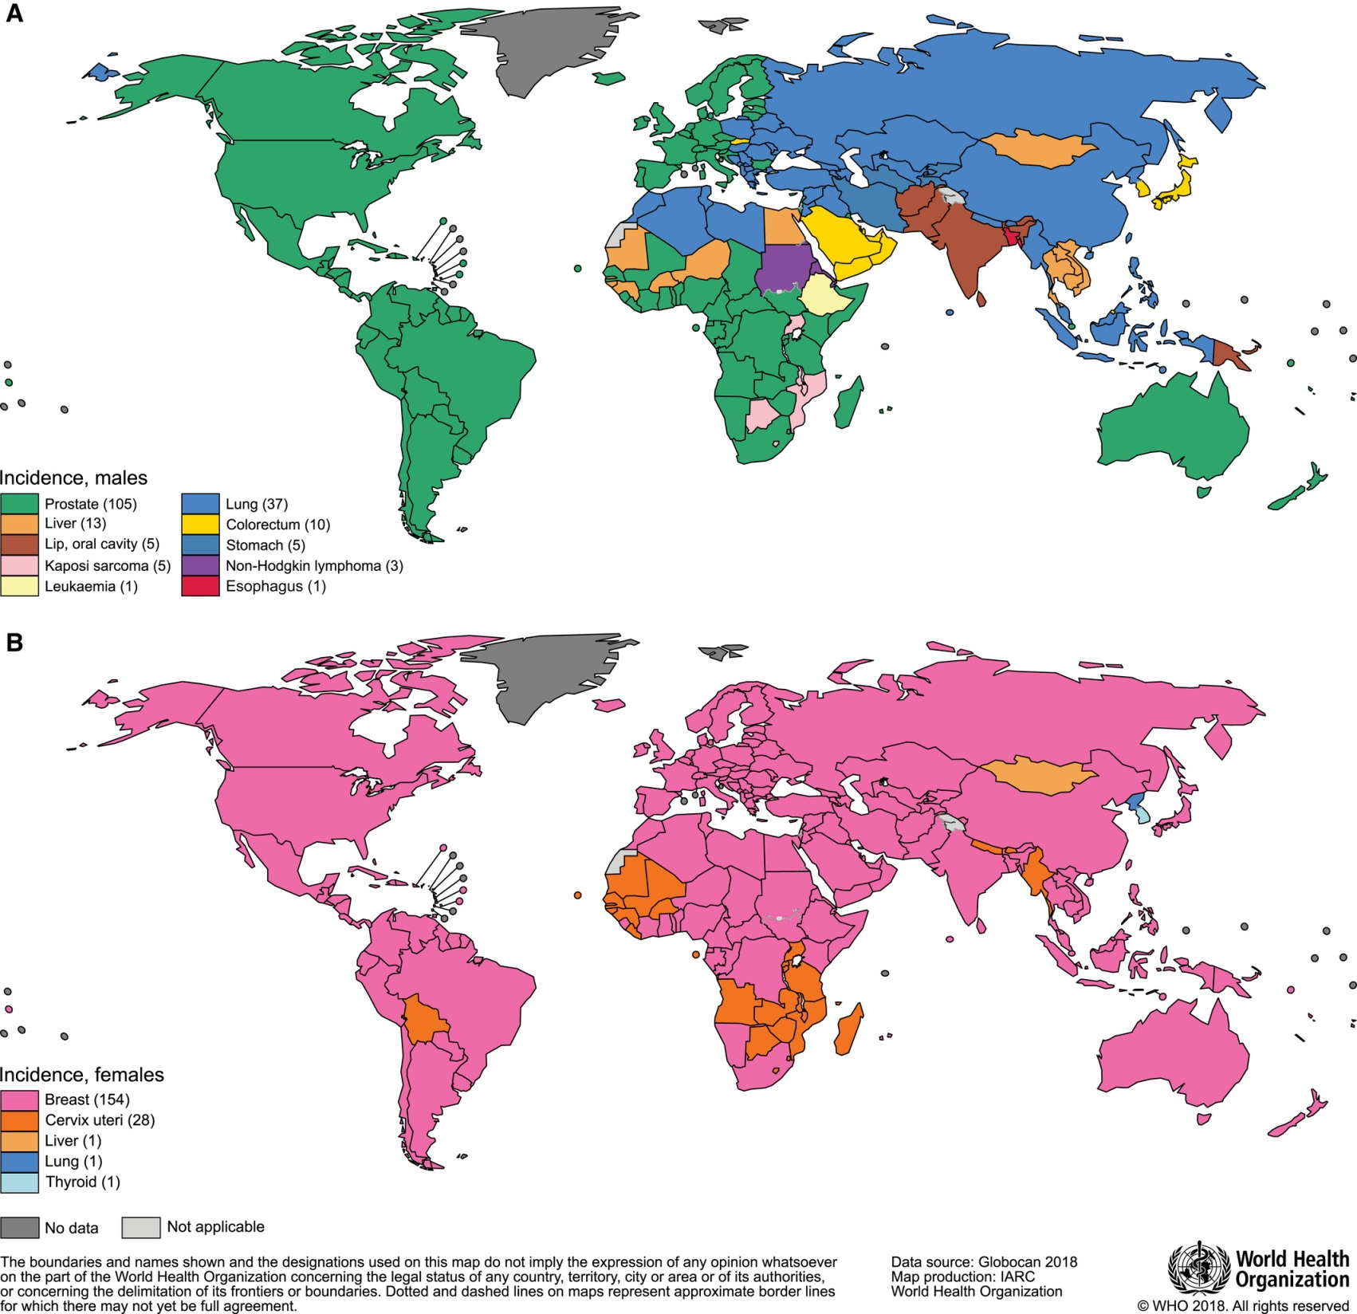

Slide 17
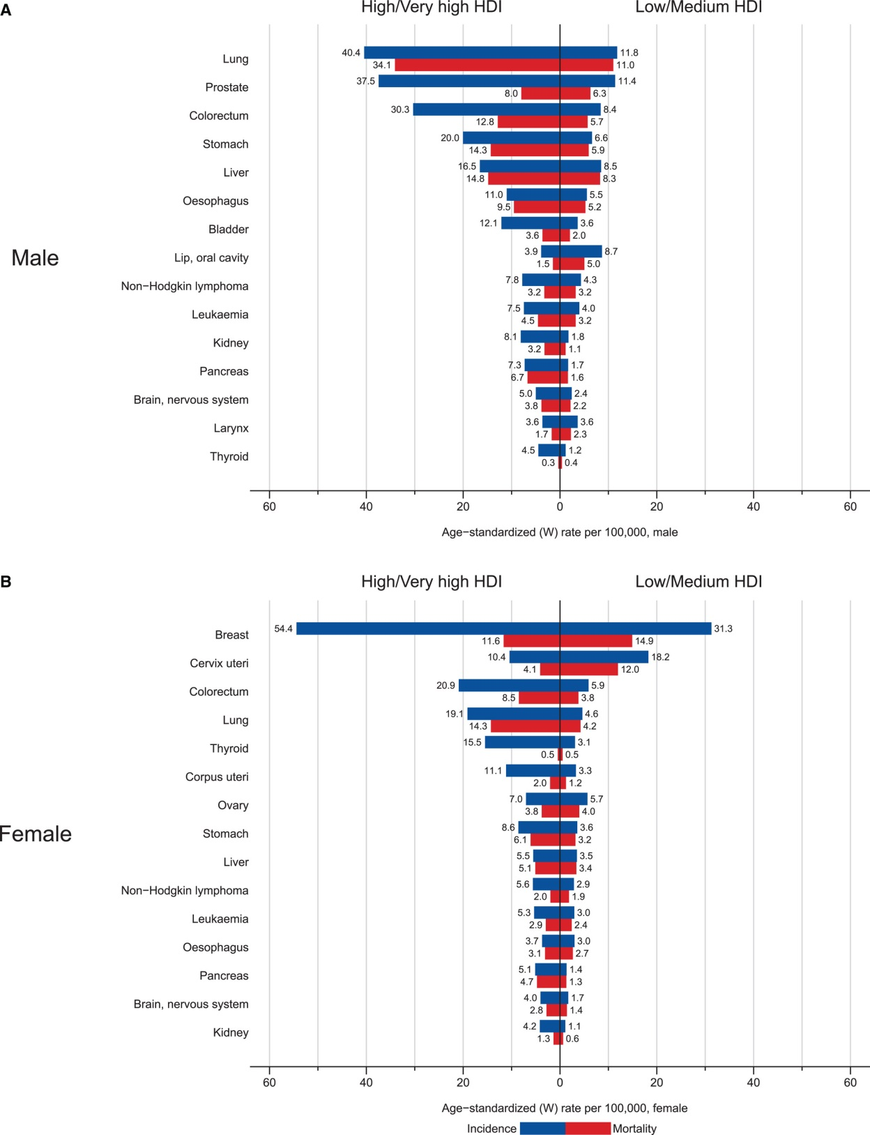

Slide 18
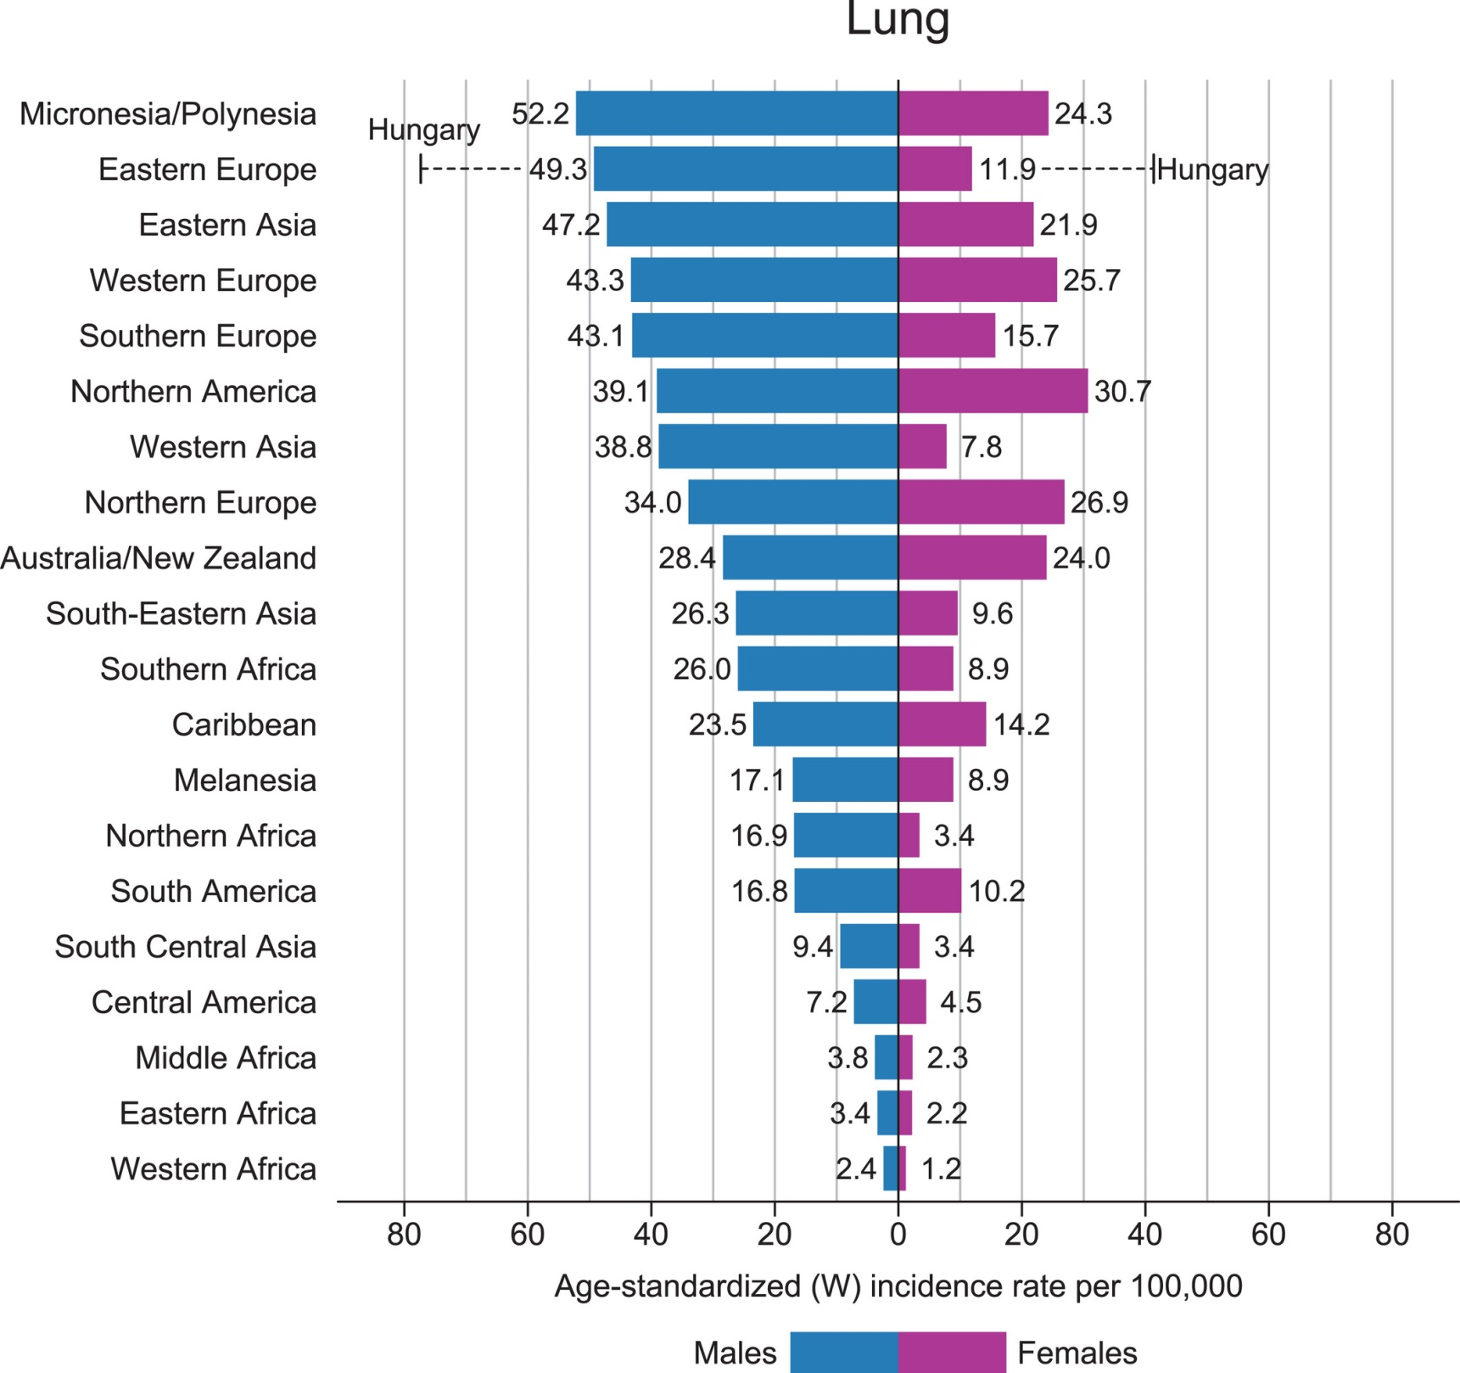

Slide 19
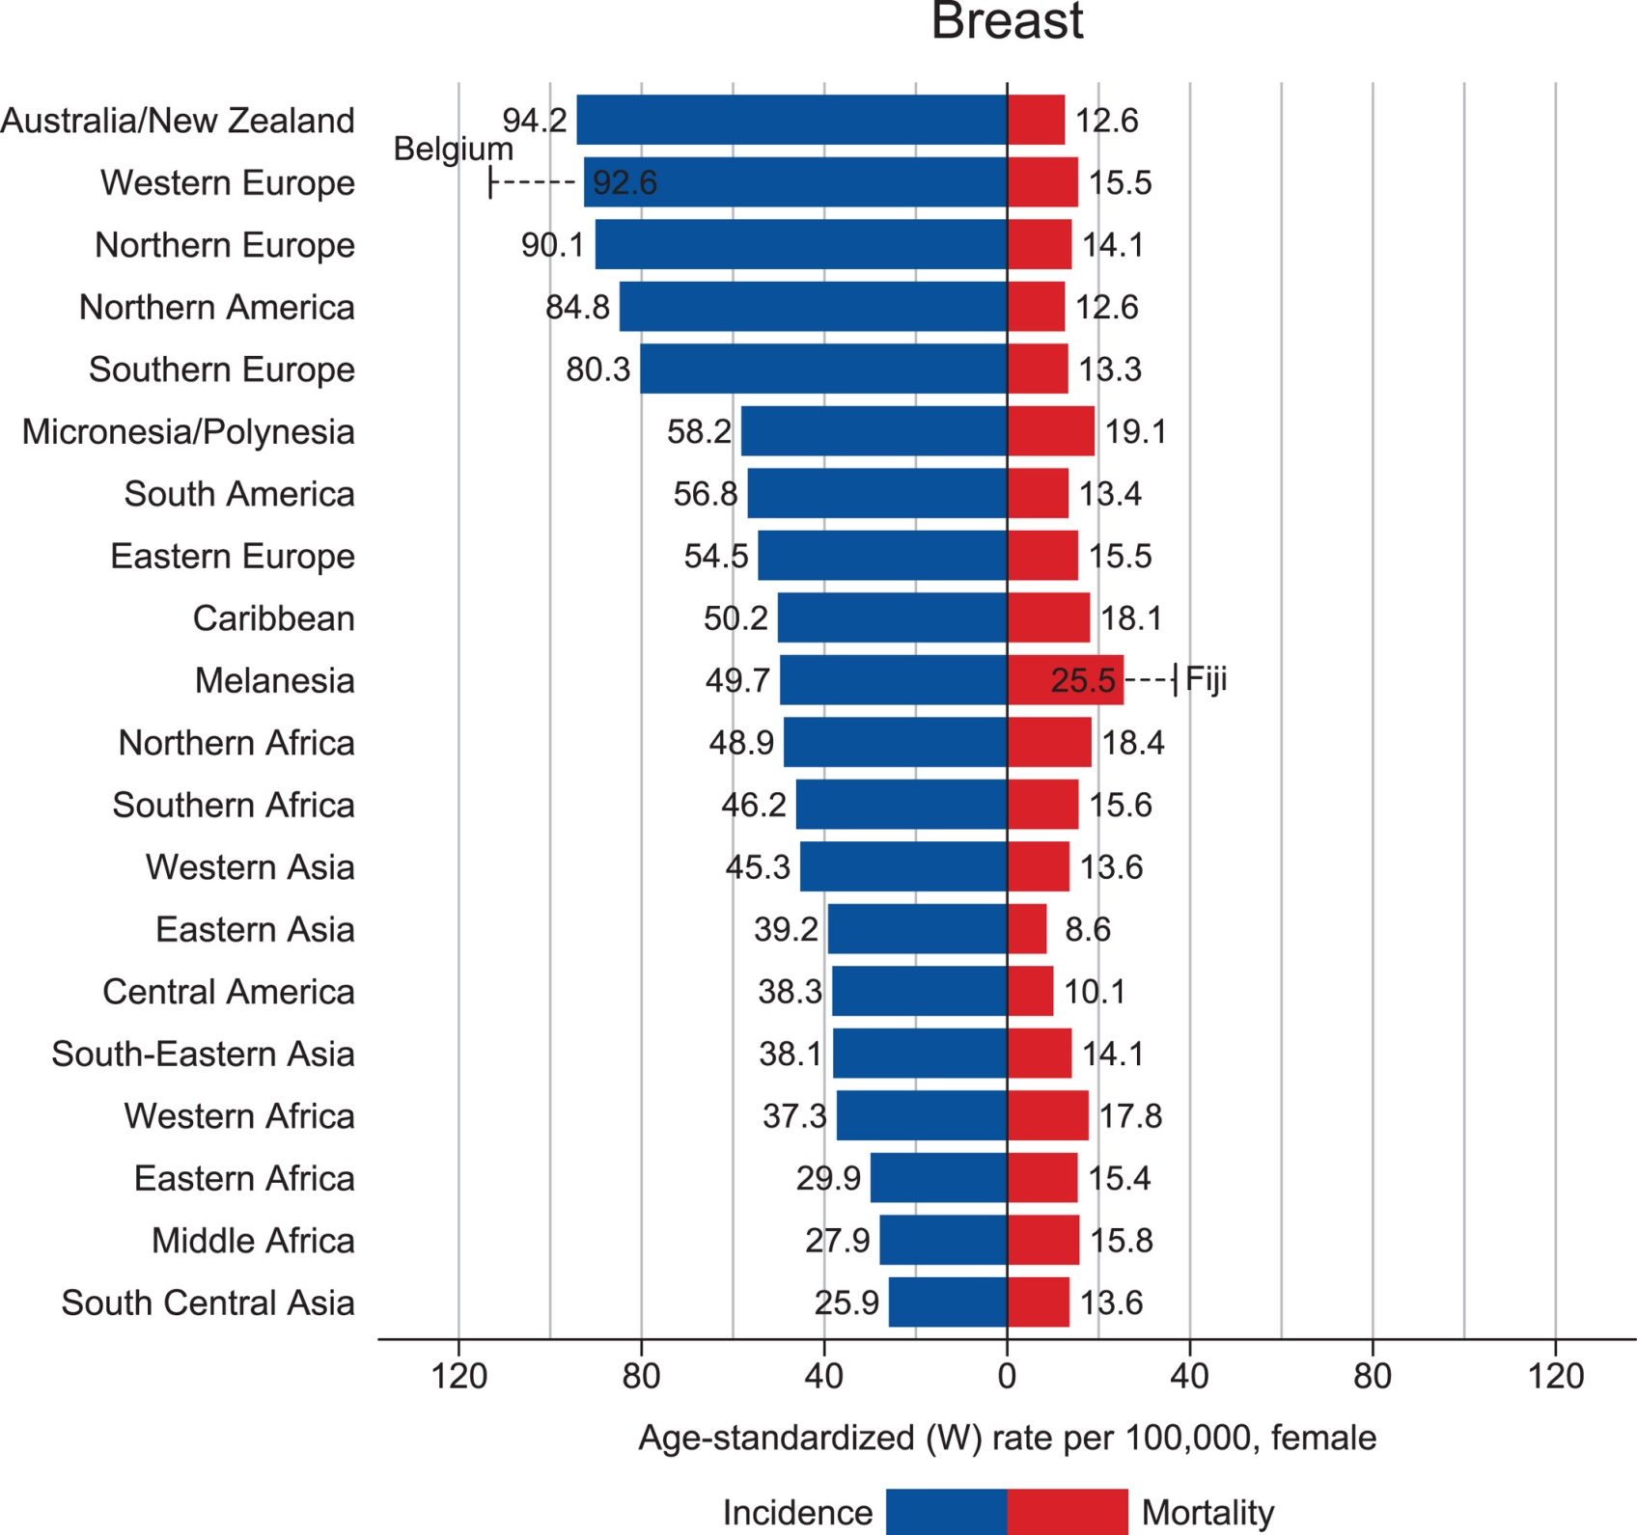

Slide 20
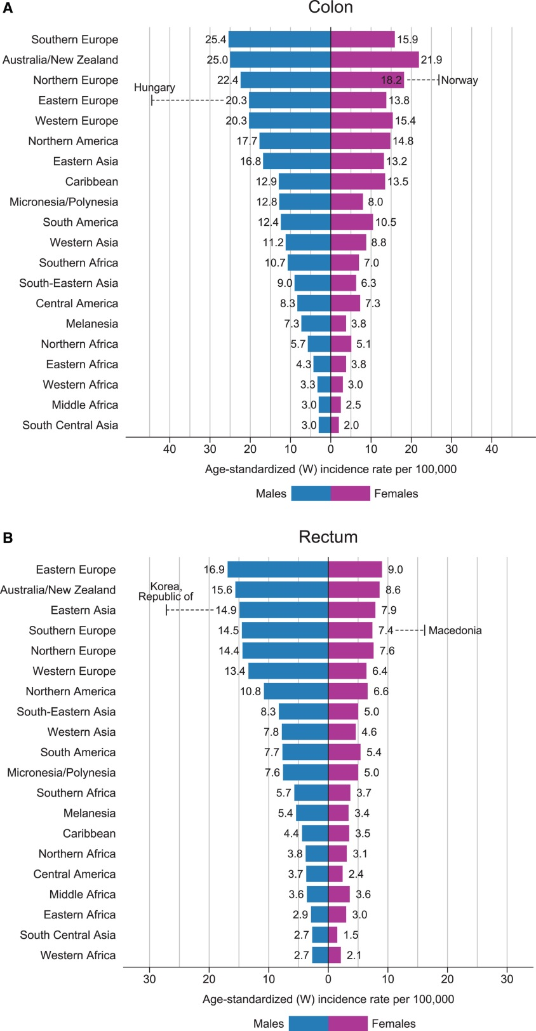

Slide 21
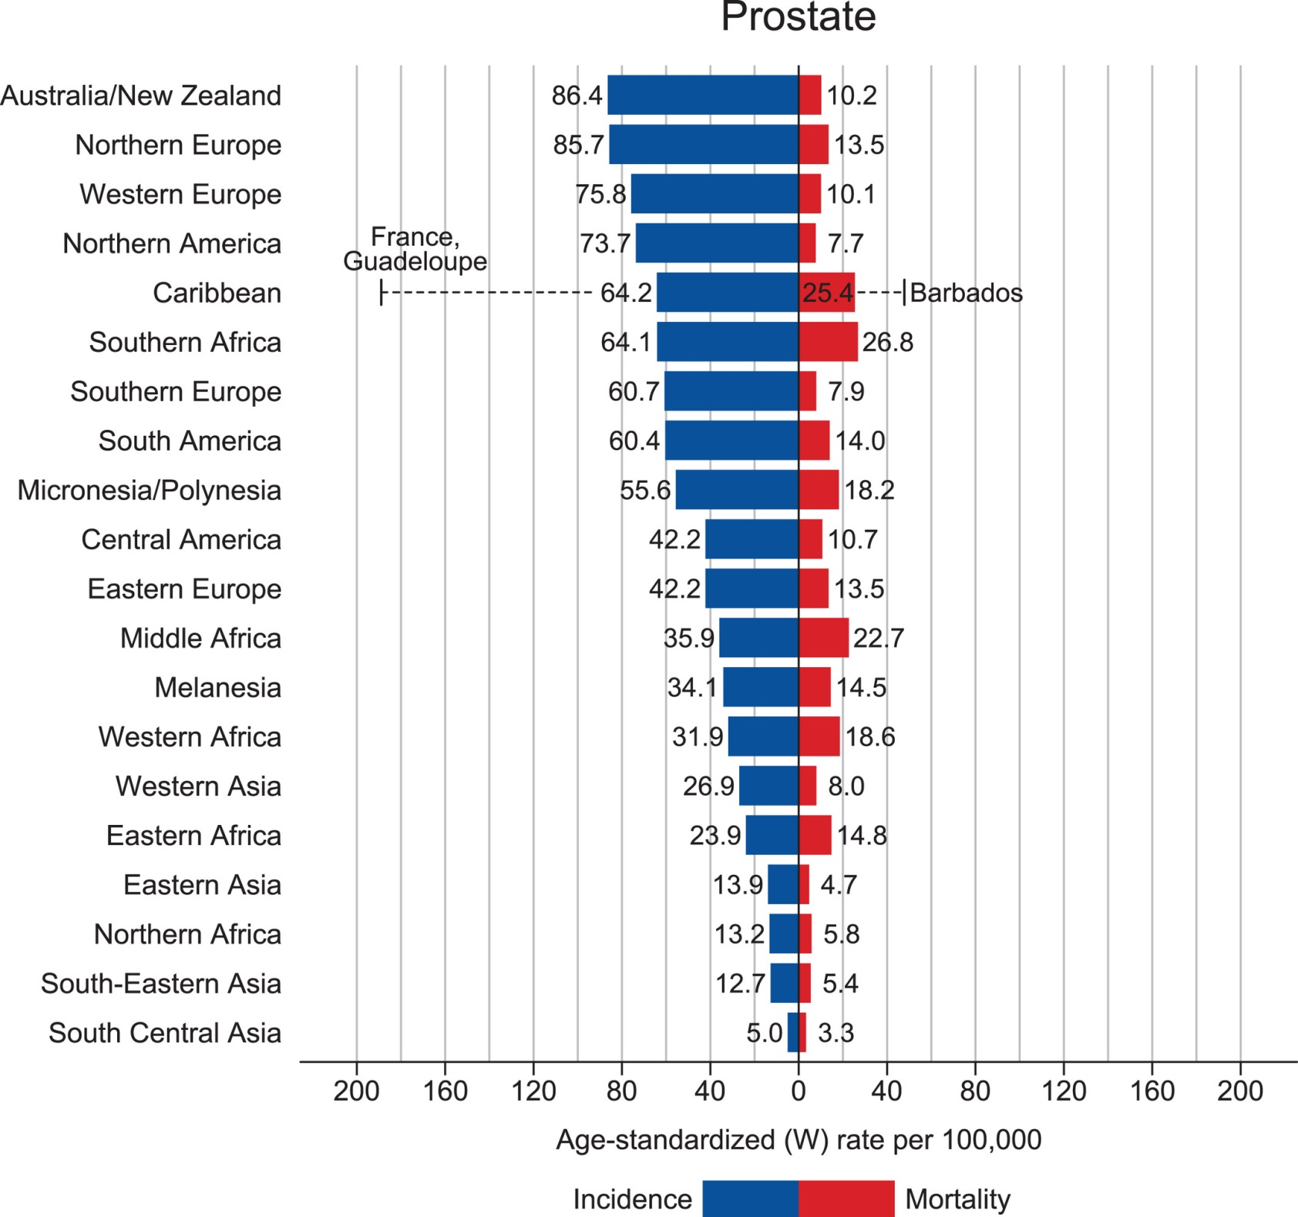

Slide 22
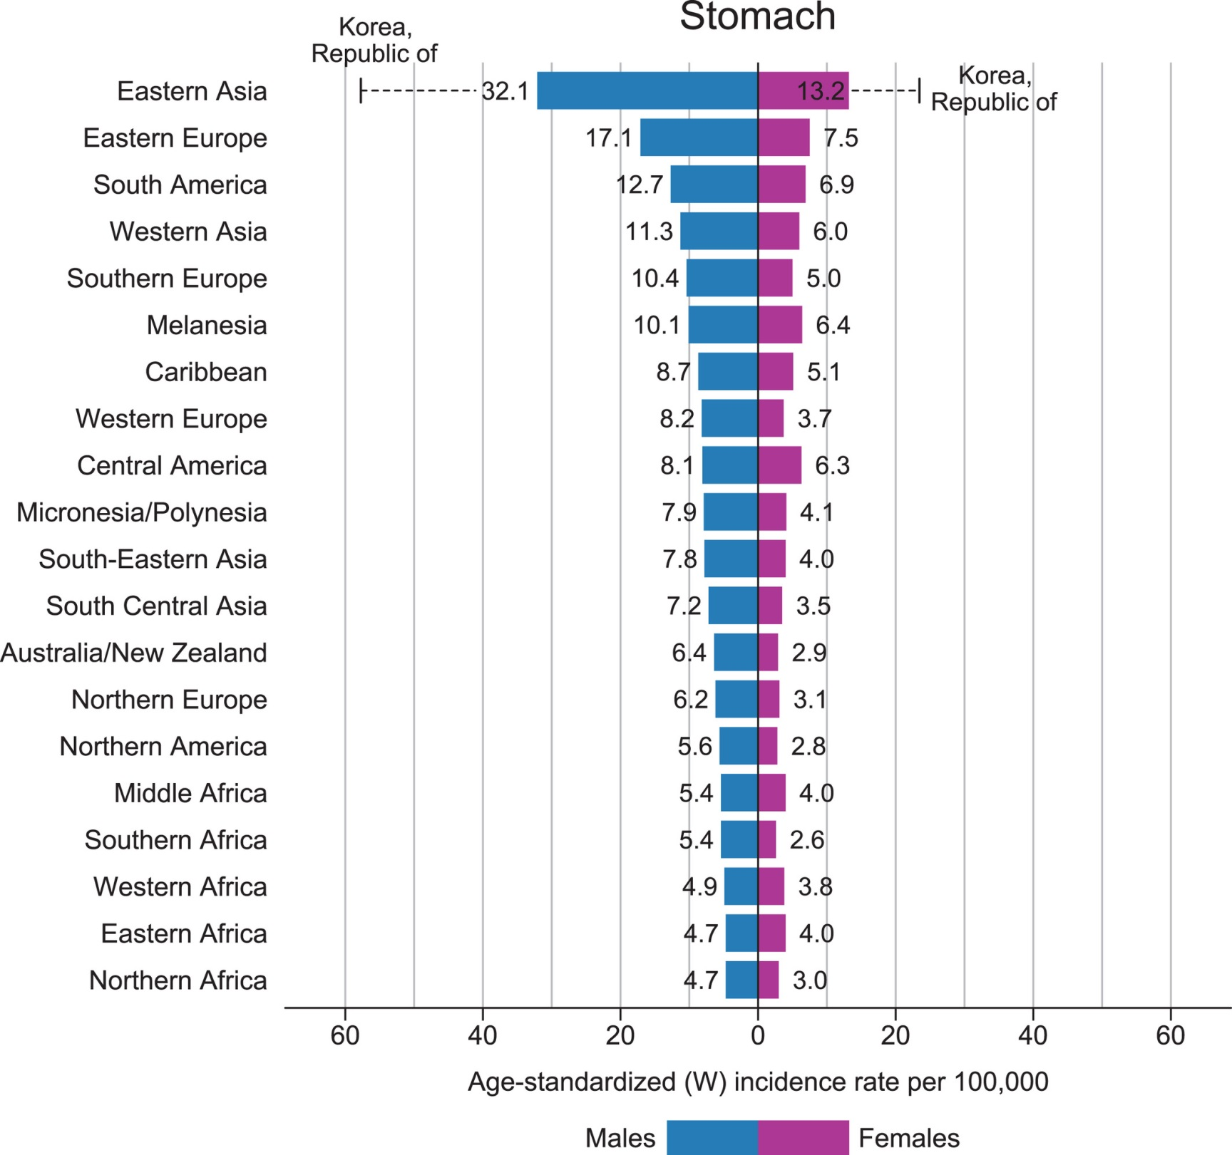

Slide 23
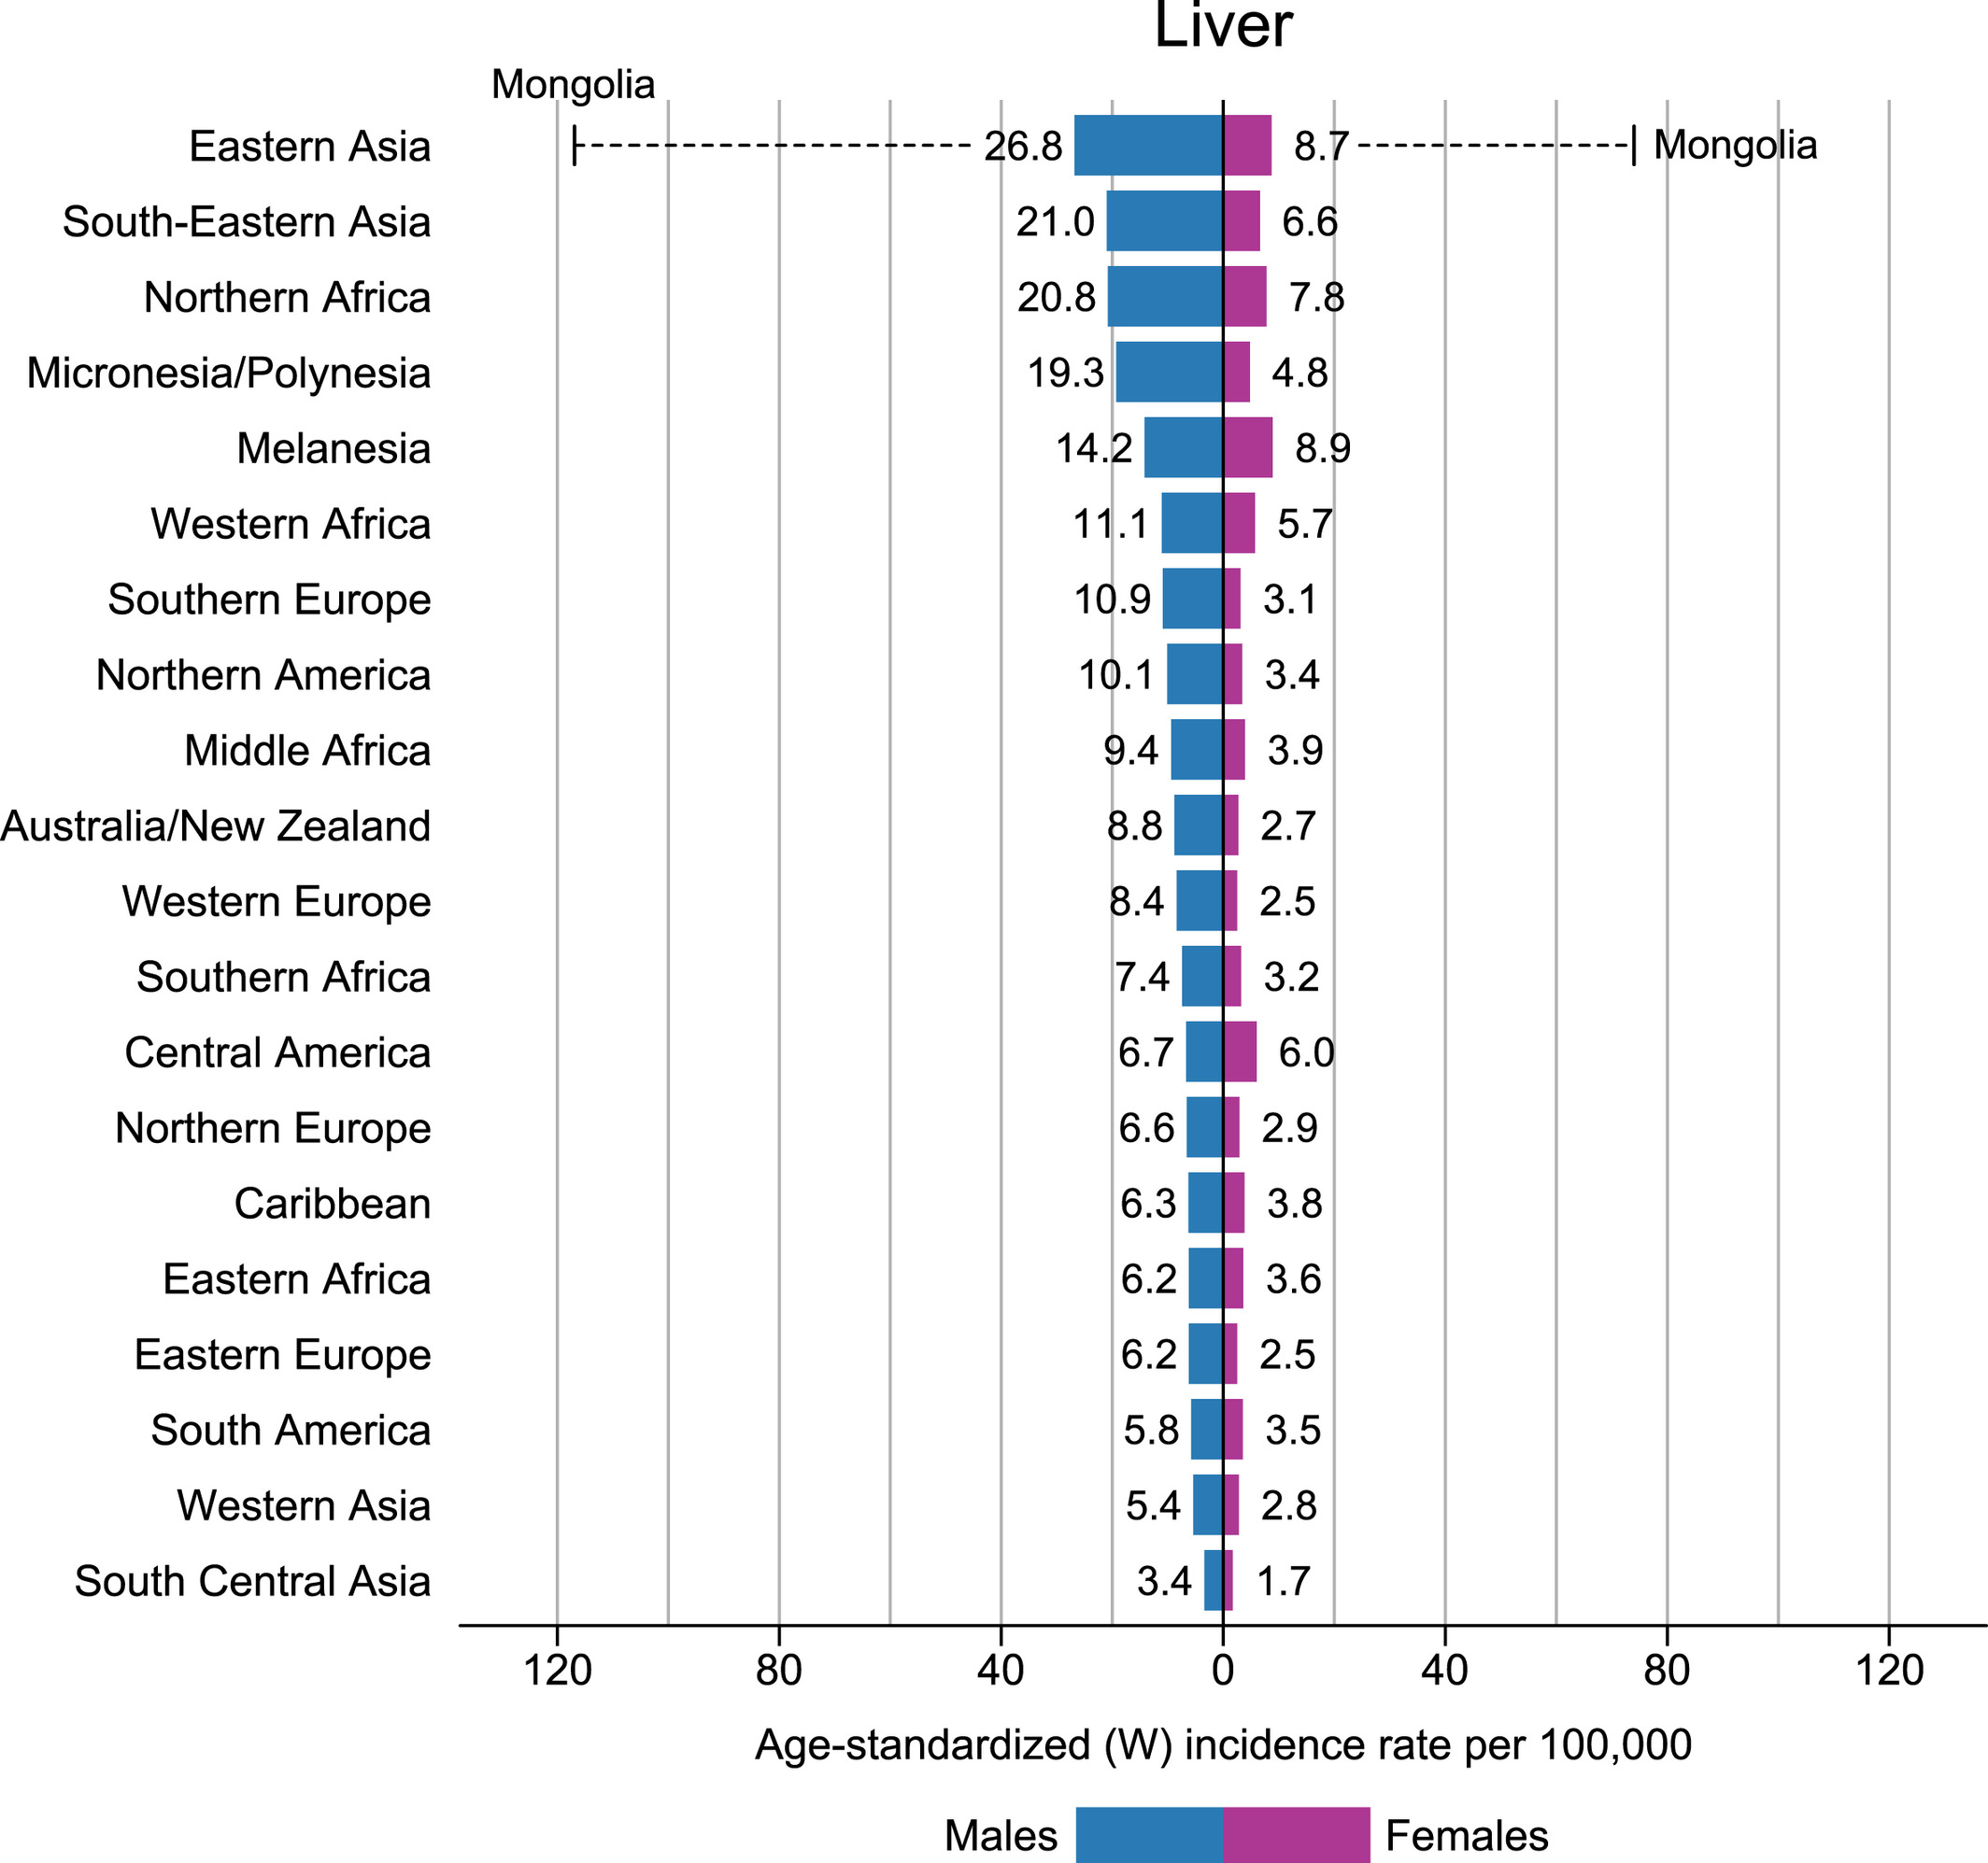

Slide 24
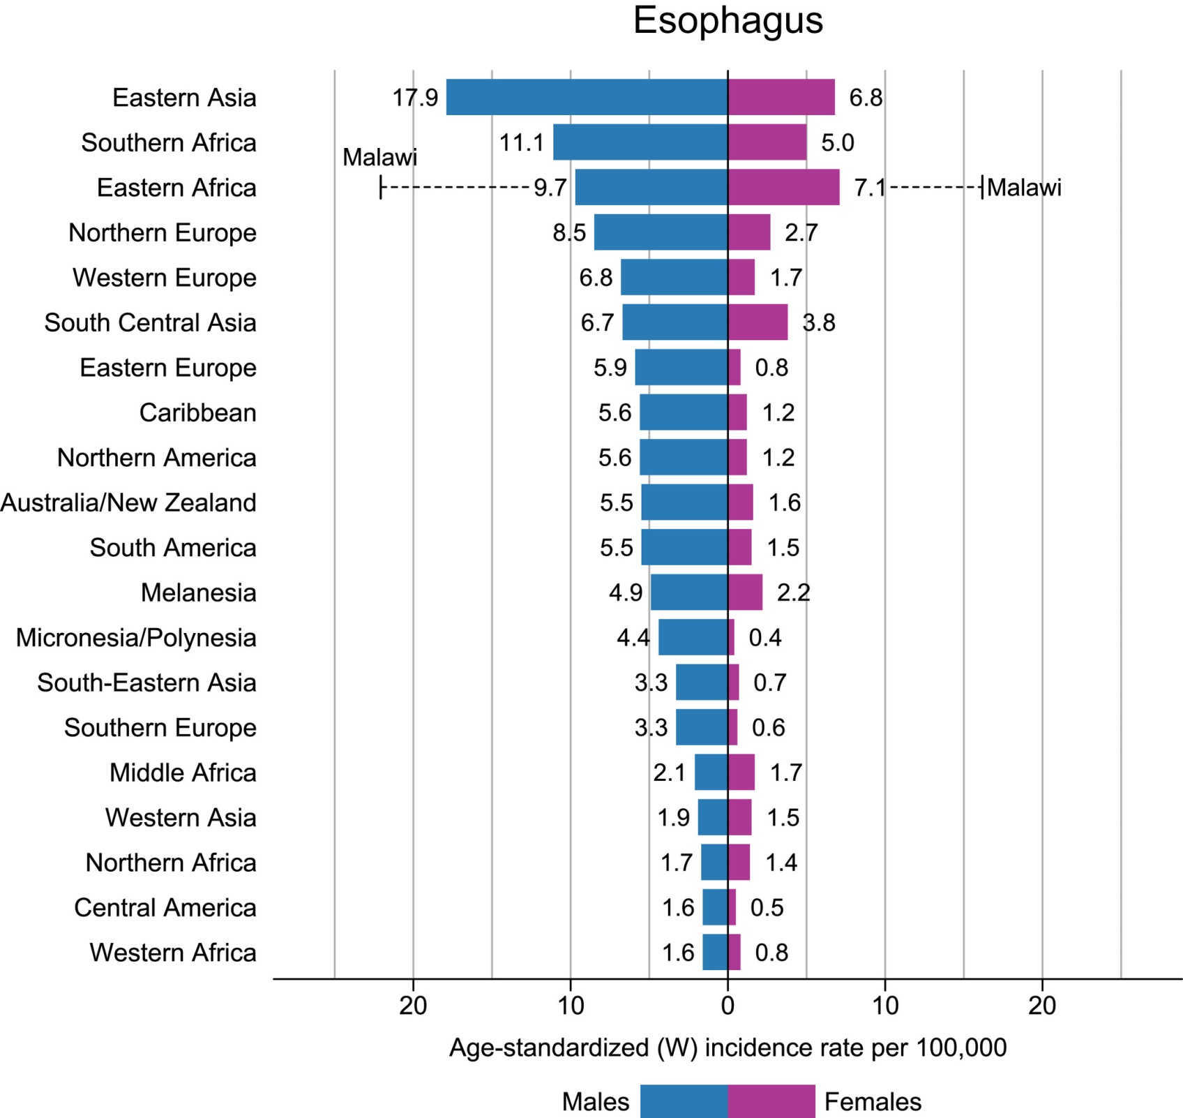

Slide 25
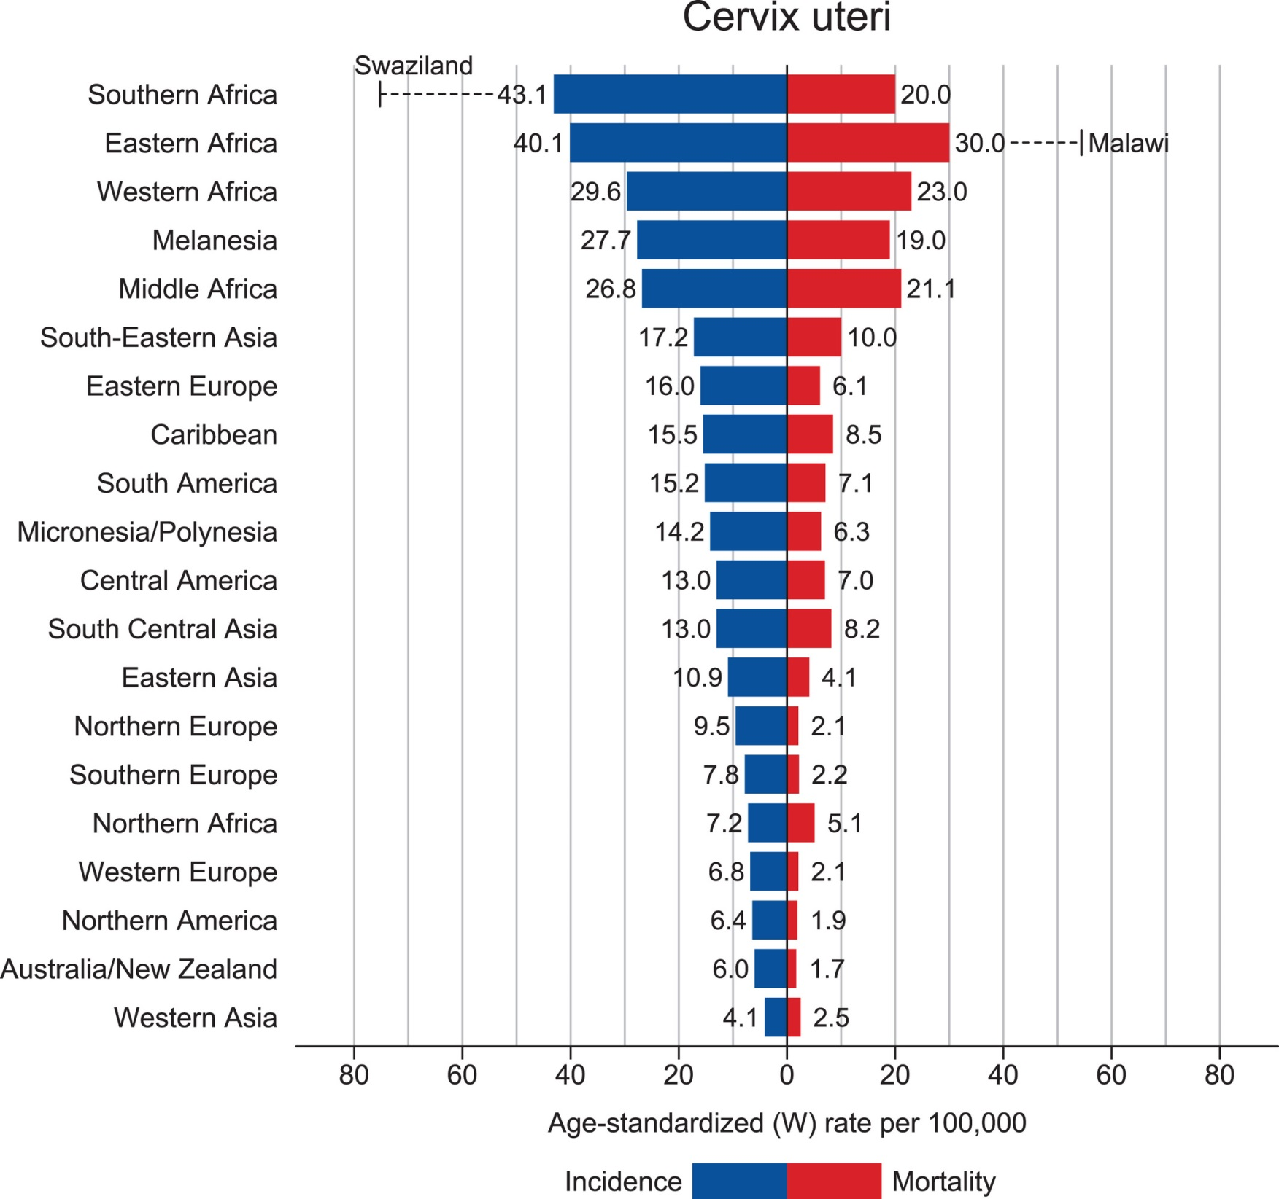

Slide 26
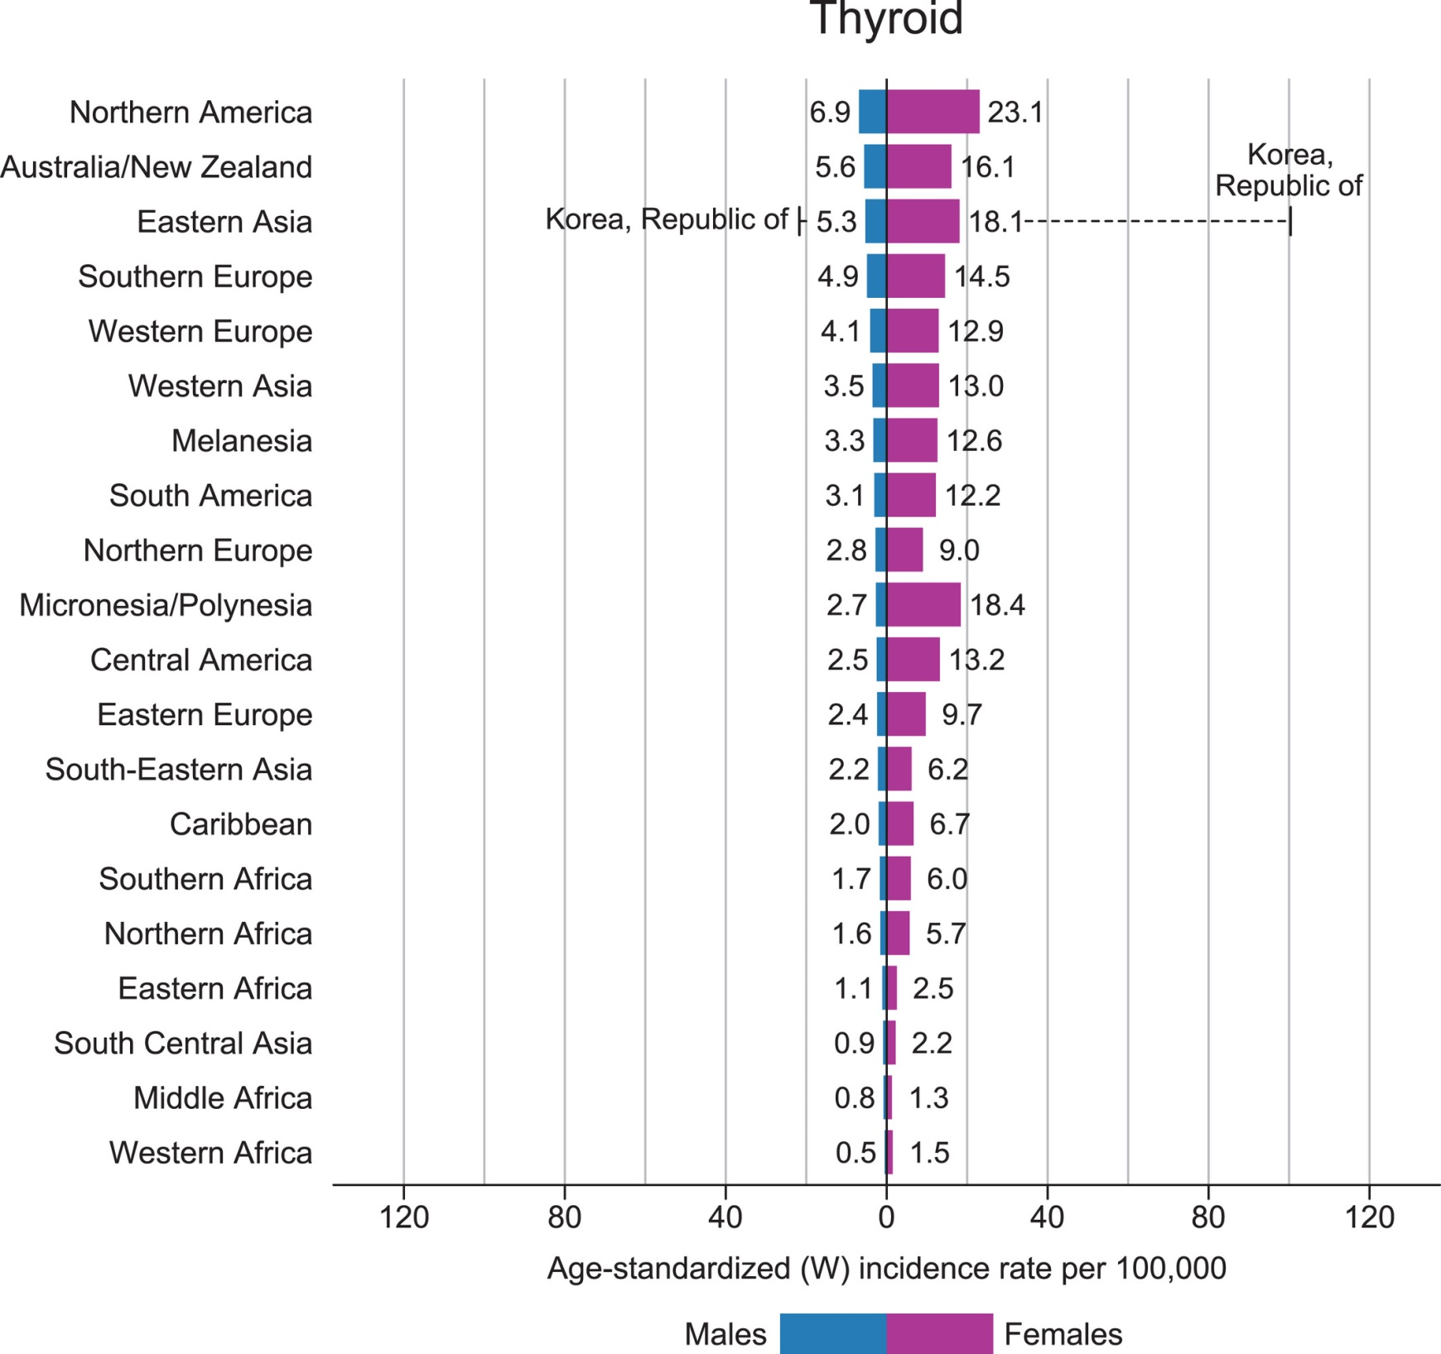

Slide 27
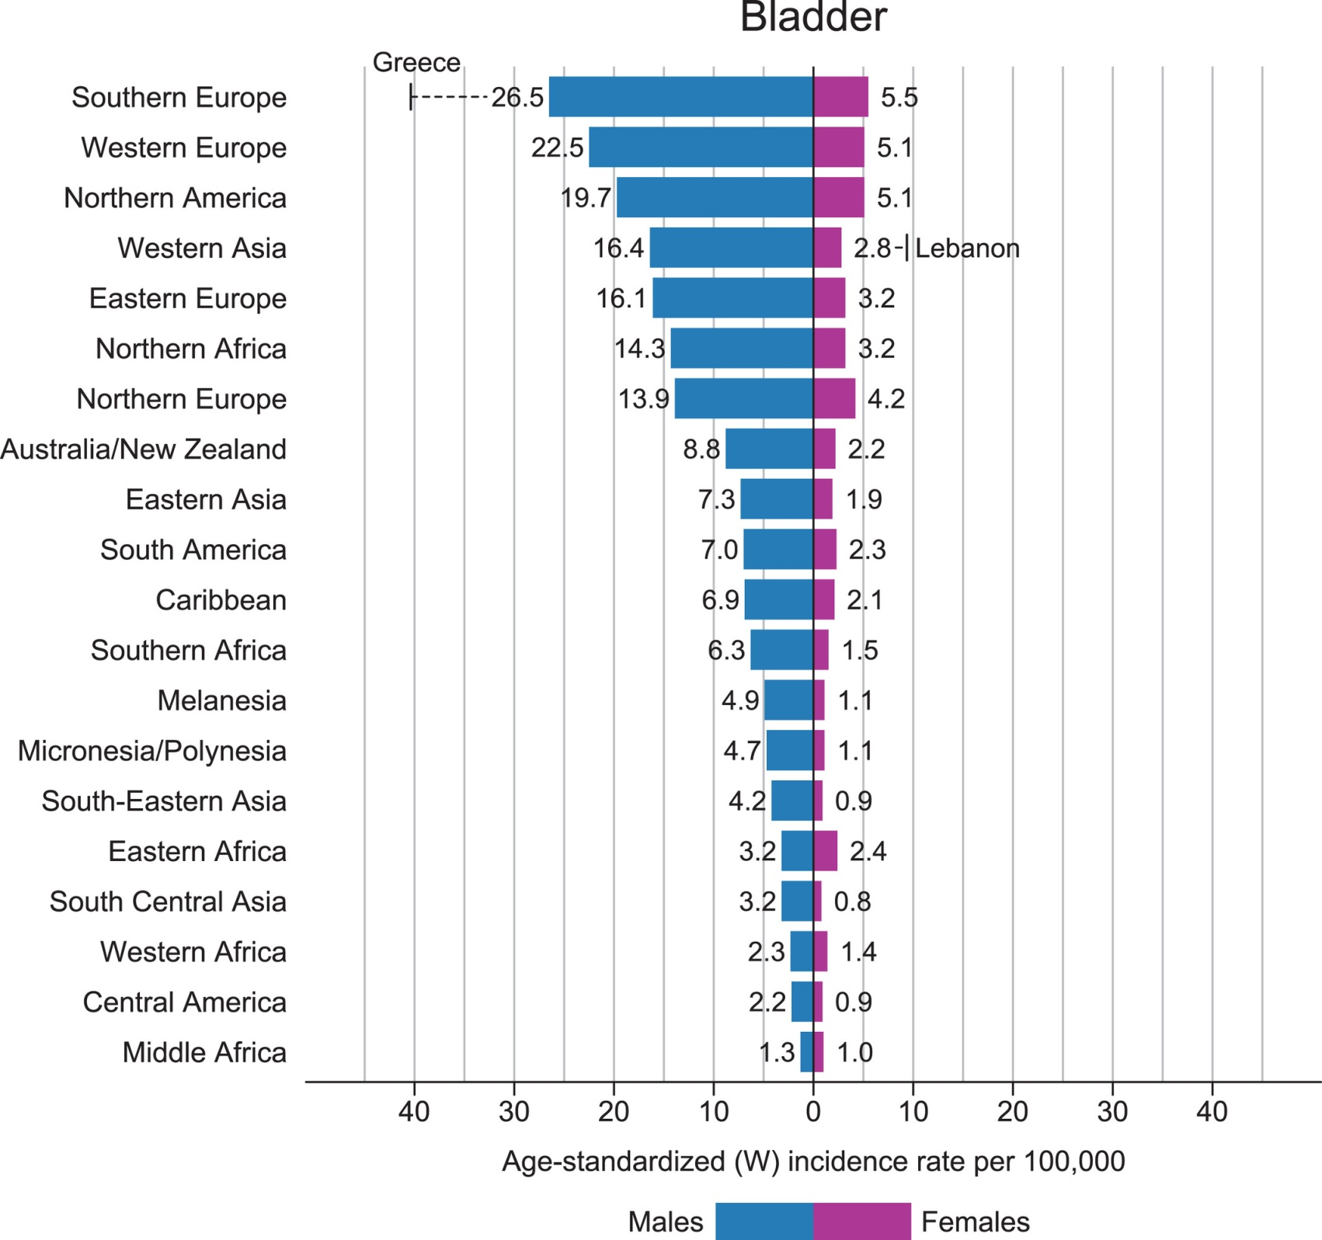

Slide 28
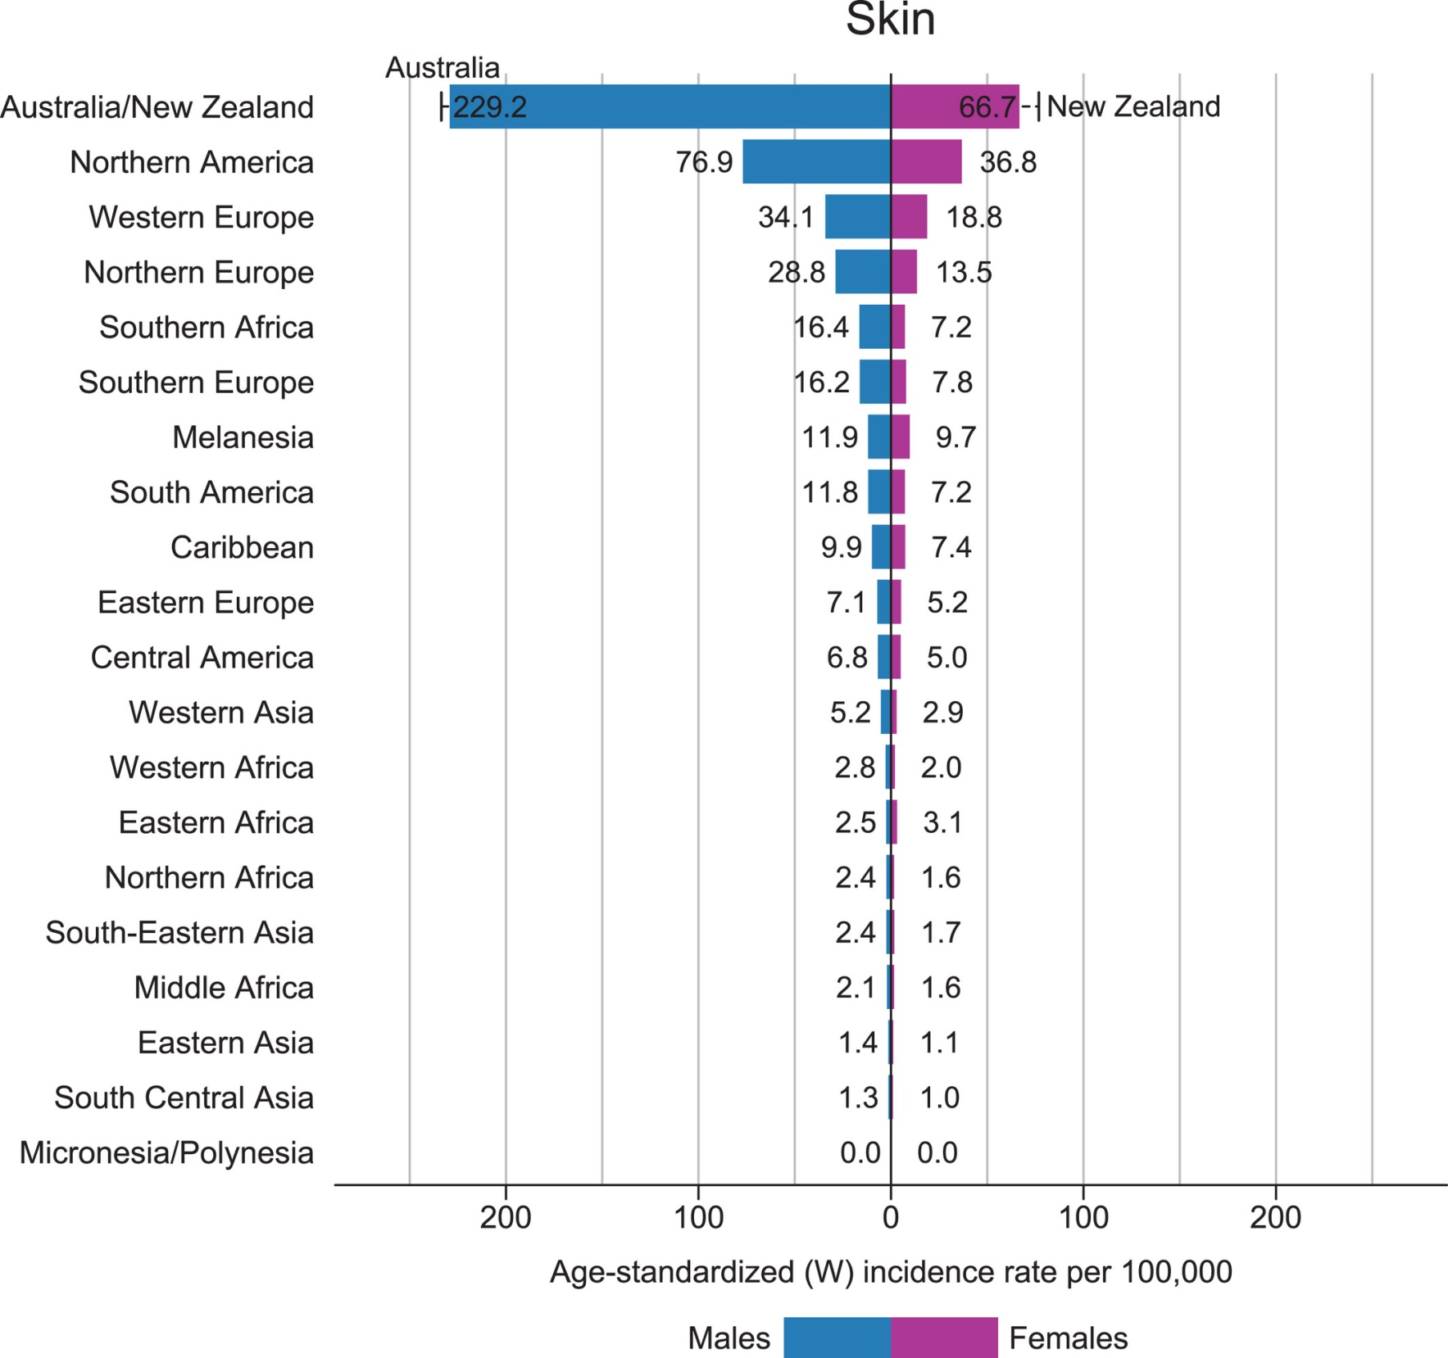

Slide 29
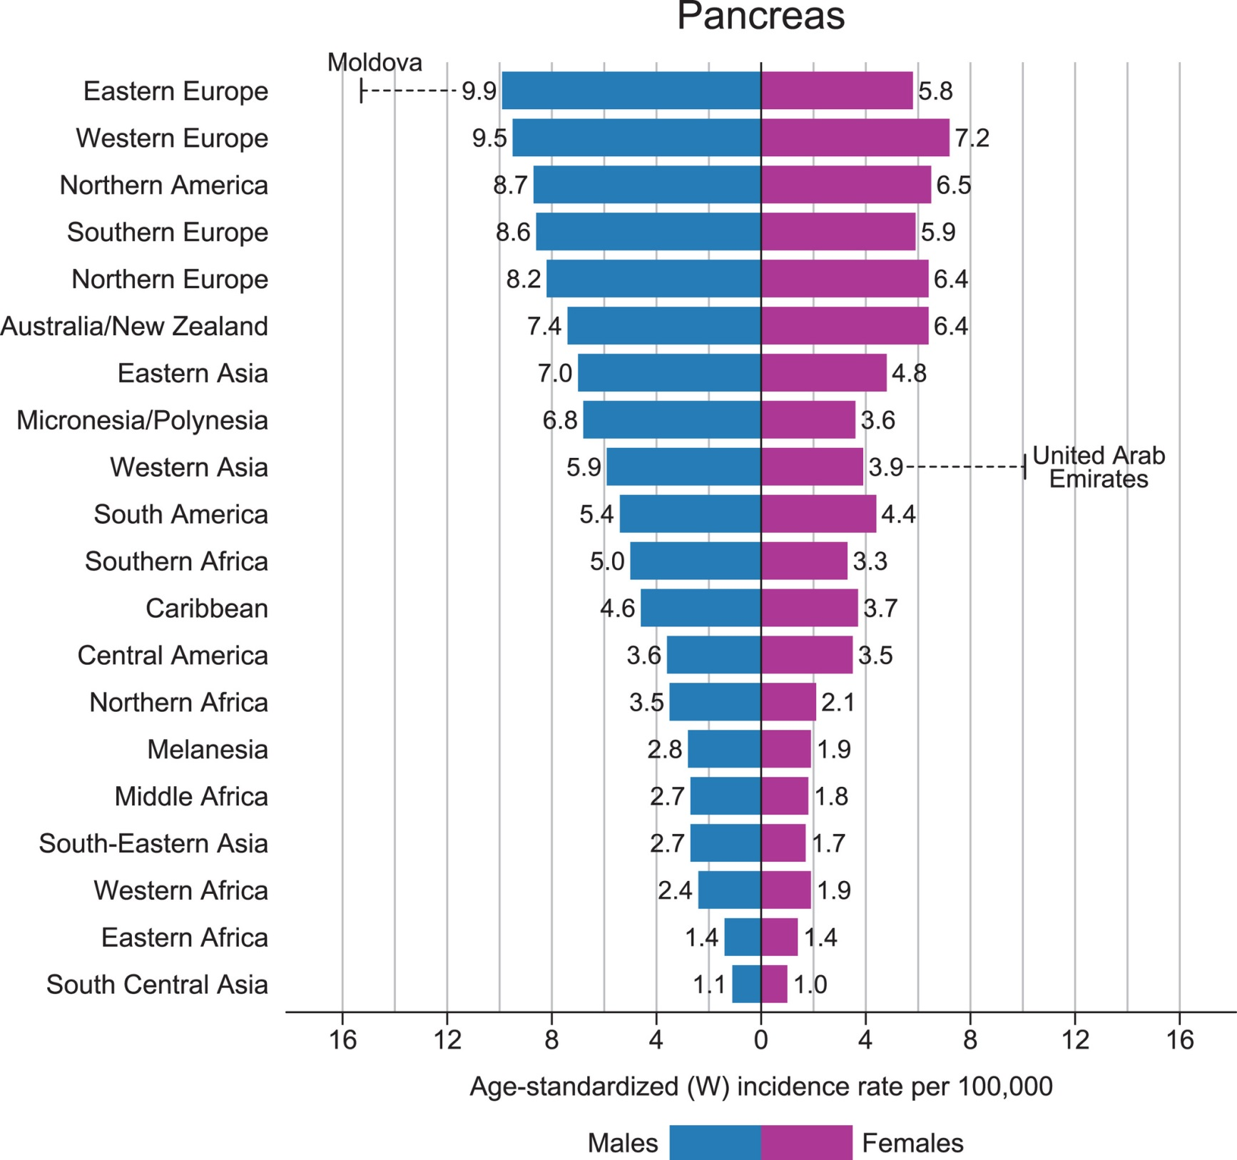

Slide 30
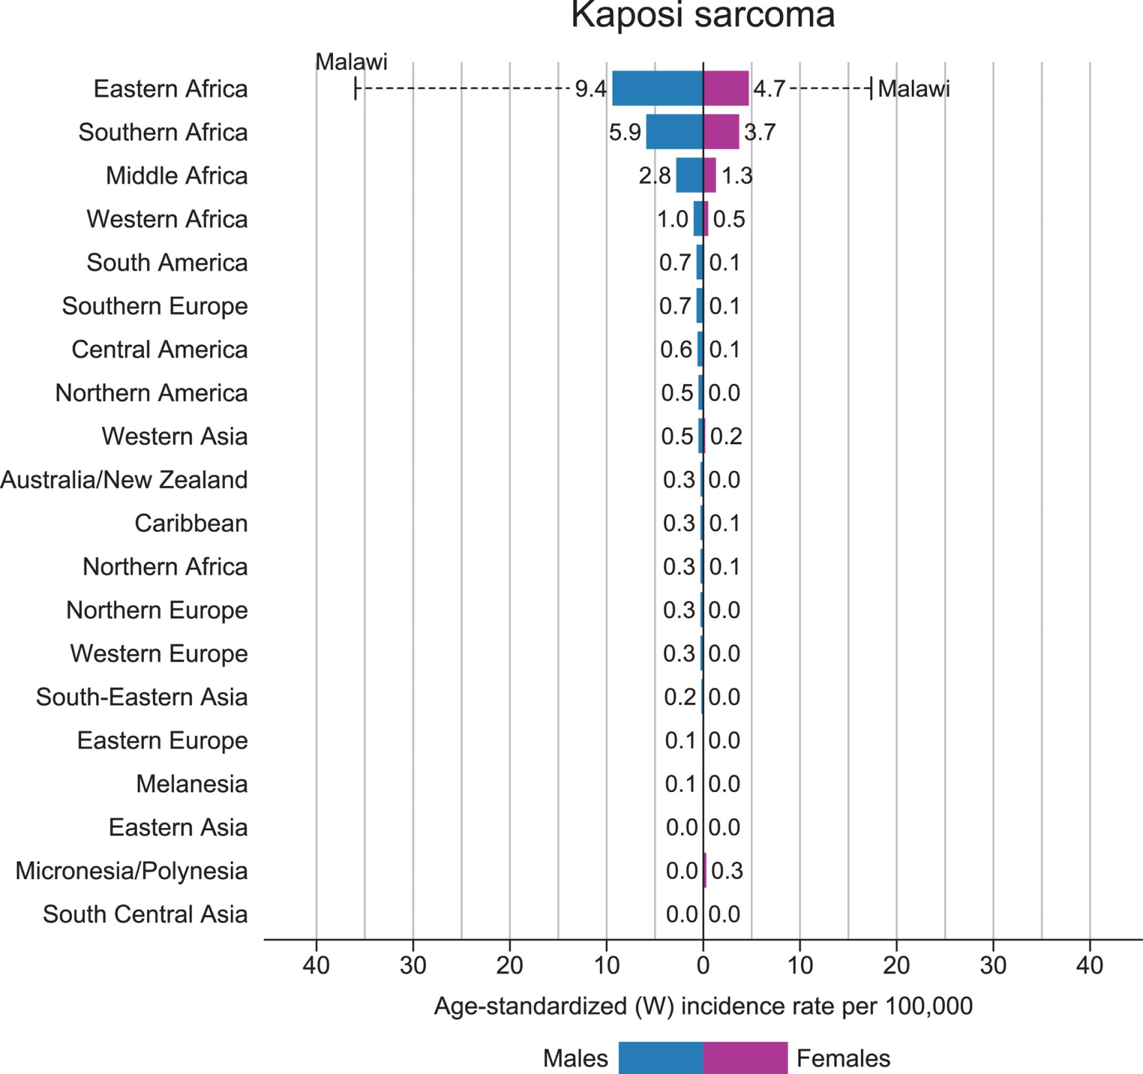

Slide 31
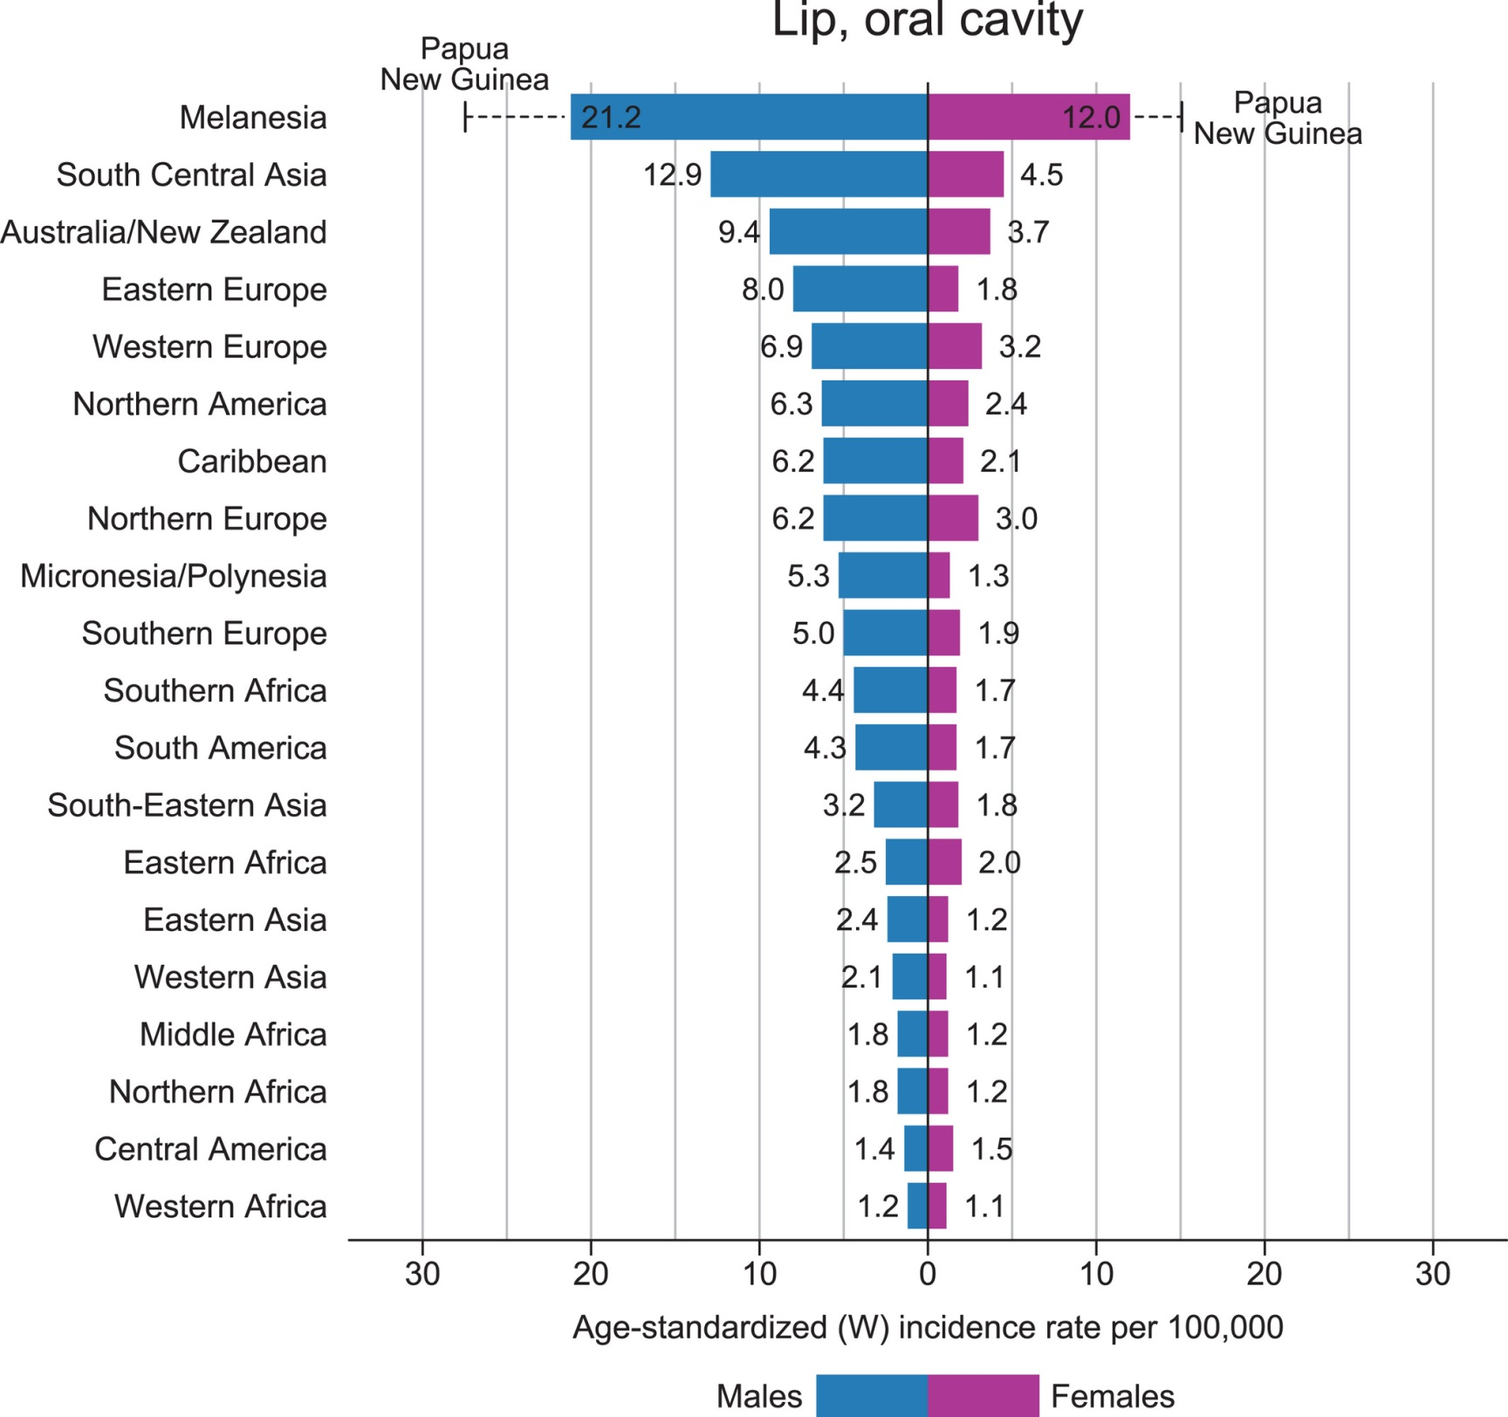

Slide 32
Etiology and risk factors
Research in the field of cancer epidemiology has shown that the cause of 90-95% of cancer is carcinogenic environmental and lifestyle factors. Among them,
smoking is the cause of 30%
diet (fat)- 35%,
infectious agents - 10%,
occupational carcinogens - 4-5%,
ionizing radiation - 4-5%,
ultraviolet radiation - 2-3%,
consumption of alcoholic beverages - 2-3%,
air pollution - 1-2%
reproductive factors - 4-5%,
low physical activity - 4-5%.

Slide 33
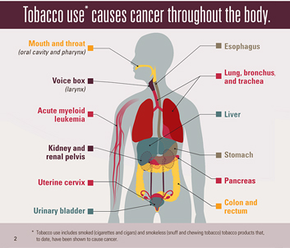
Smoking
Smoking is the direct cause of development cancer of the oral cavity and pharynx, esophagus, larynx, lung, pancreas, renal pelvis, bladder, and possibly stomach, and belongs to the first group of factors whose carcinogenicity for humans proven.

Slide 34
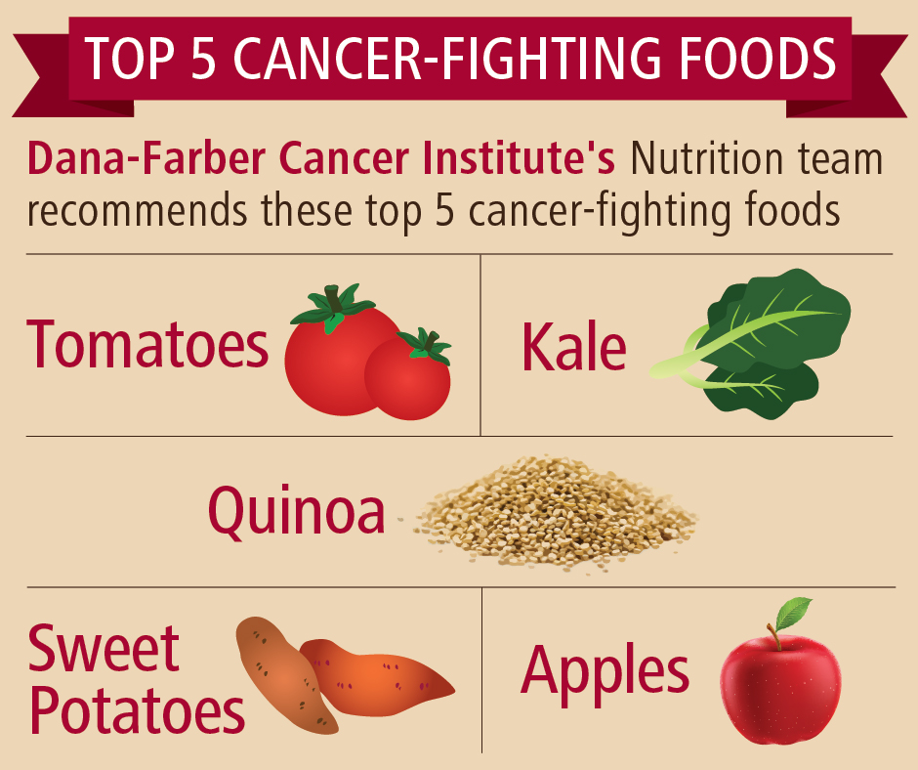
Diet and cancer

Slide 35
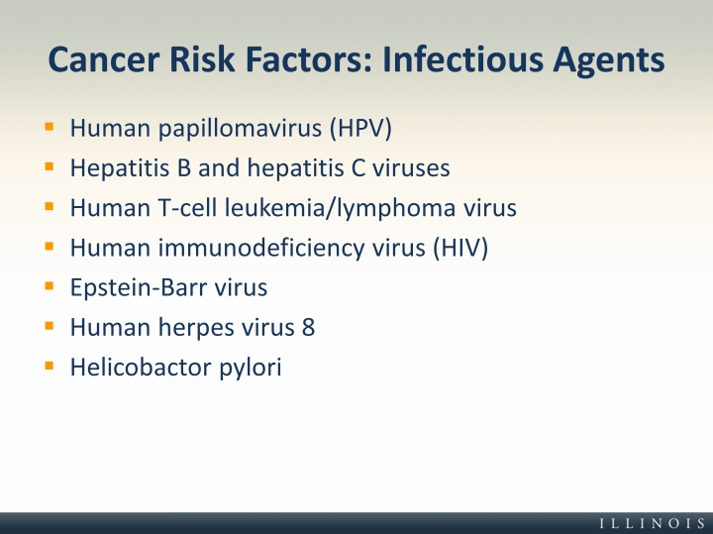
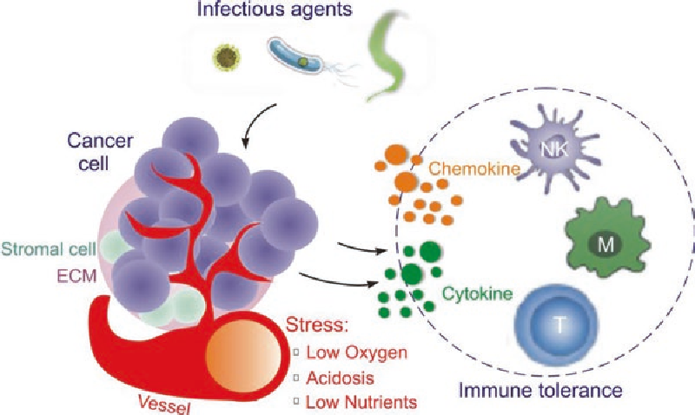
Infectious agents

Slide 36
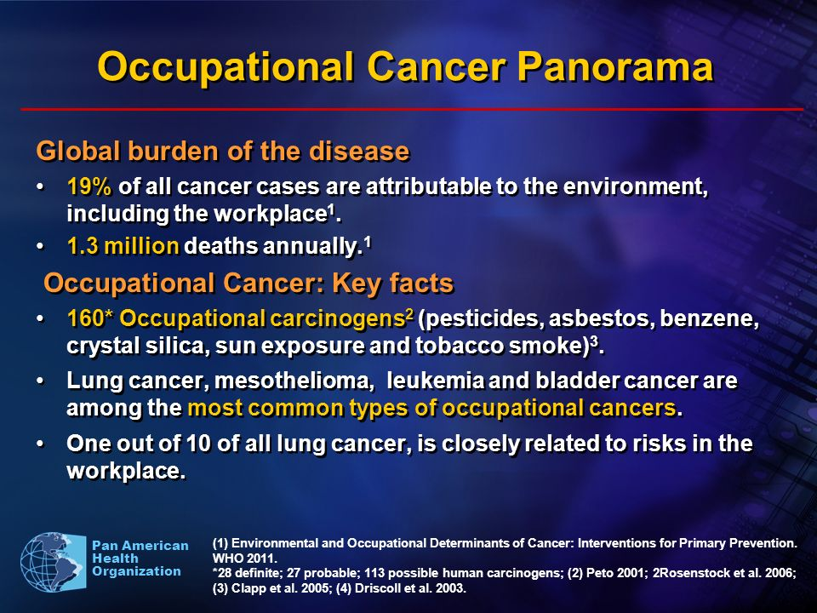
Occupational carcinogens

Slide 37
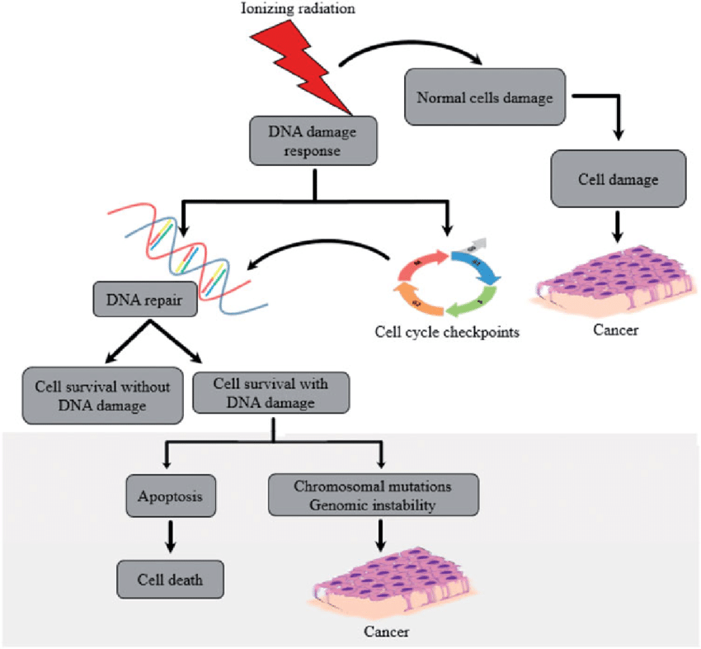
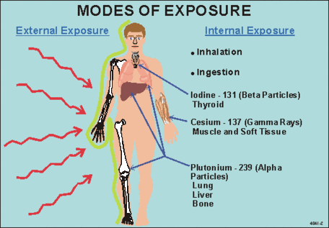
Ionizing radiation

Slide 38
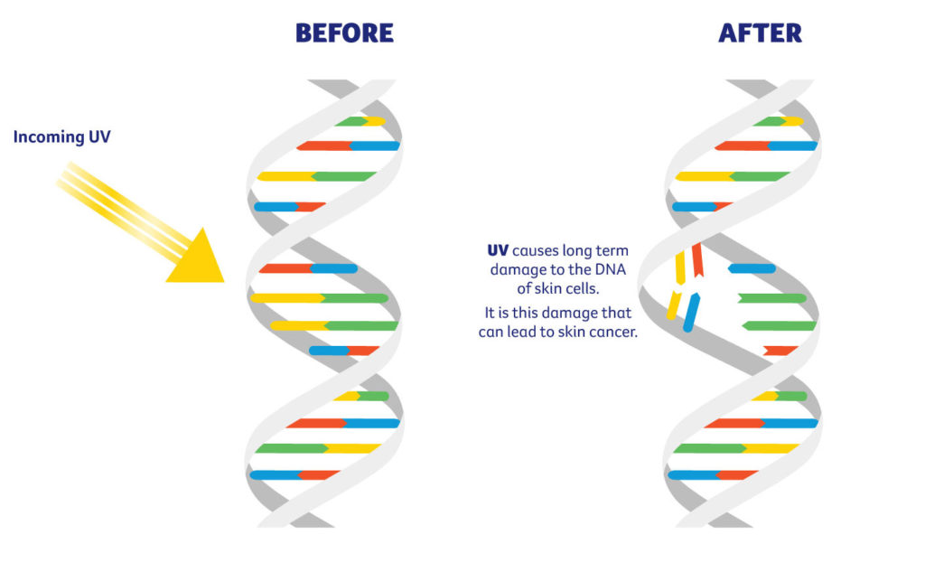
UV

Slide 39
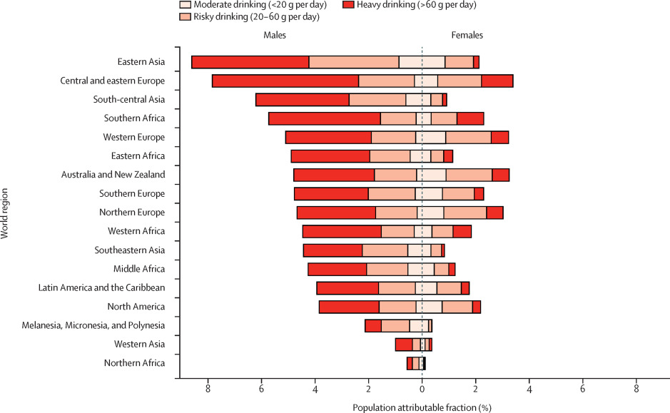
Alcohol

Slide 40
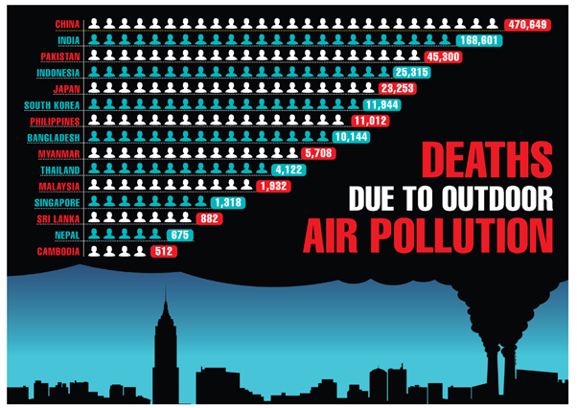

Slide 41
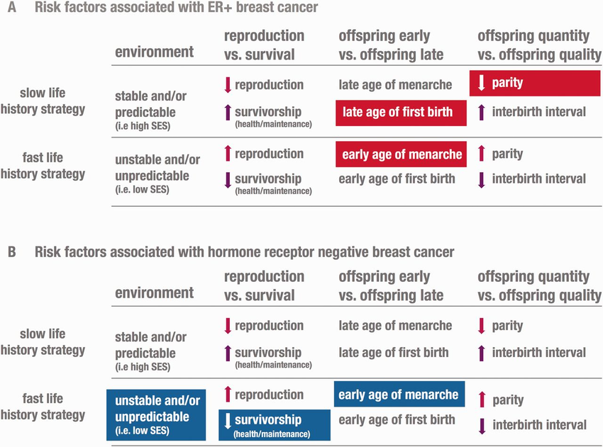
Reproductive factors

Slide 42
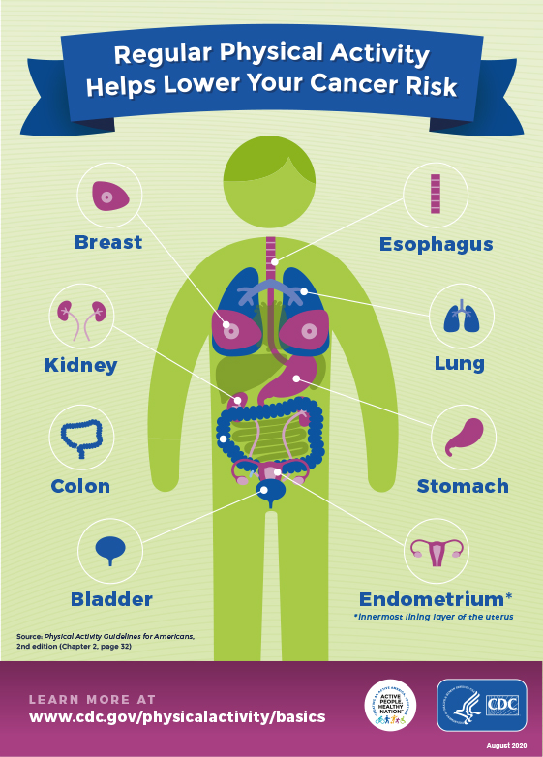
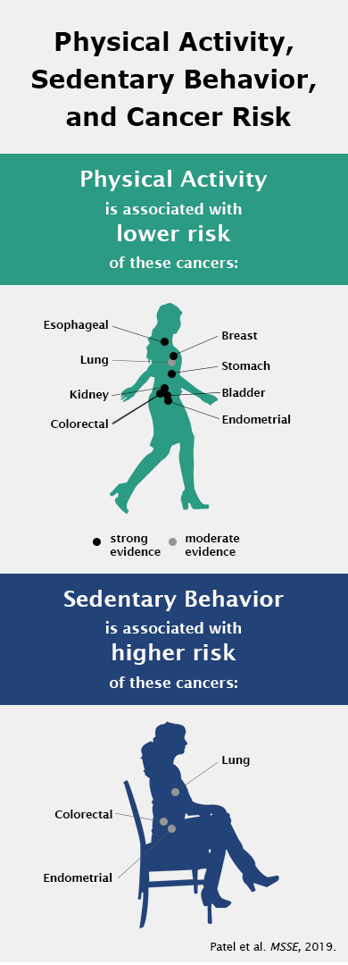
Low physical activity

Slide 43
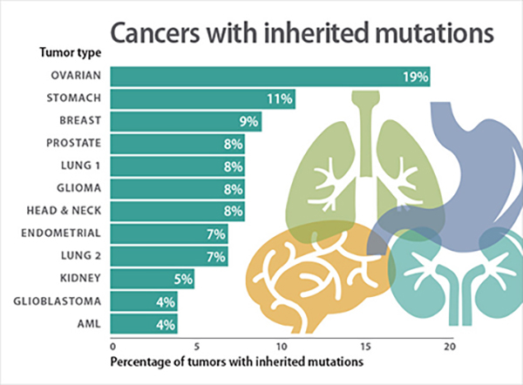
Cancer and heredity

Slide 44


